Slide 1
COMPUTER VISION

Slide 2
Components of Computer Vision System and Applications in Different Bands of EM Spectrum
A computer vision system allows a computer to understand and analyze images or videos.
Main components are:
Image Acquisition
  Captures an image using a camera, scanner, sensor, etc.
  Converts the real-world scene into a digital image.
Pre-processing
  Improves the quality of the image.
  Examples: noise removal, contrast enhancement, smoothing.
Segmentation
  Divides the image into meaningful regions or objects.
  Example: separating a person from the background.

Slide 3
Feature Extraction
  Extracts important information such as edges, shape, texture, and color.
Classification/Recognition
  Identifies the object present in the image.
  Example: recognizing a face, vehicle, tumor, or handwritten digit.
Decision Making
  Uses the recognized information to make a final decision.
  Example: a self-driving car decides whether to stop or move.

Slide 4
EM band | Example applications
Gamma rays | Medical imaging, nuclear medicine, astronomy
X-rays | Bone imaging, luggage/security inspection, industrial defect detection
Ultraviolet (UV) | Forensics, semiconductor inspection, skin analysis
Visible light | Face recognition, traffic monitoring, robotics, photography
Infrared (IR) | Night vision, thermal imaging, fire detection
Microwave | Radar imaging, weather monitoring, remote sensing
Radio waves | Radio astronomy, communication-related sensing

Slide 5
Point Processing Operations with Equation, Graph, Effect and Applications
Point processing is an image processing technique in which the output pixel depends only on the value of the corresponding input pixel.
s=T(r)
Where:
r = input pixel intensity
s = output pixel intensity
T = transformation function

Slide 6
Important Point Processing Operations
1. Image Negative
Equation:
s=L−1−r
For an 8-bit image:
s=255−r
Effect: Dark pixels become bright and bright pixels become dark.
Application: Medical X-ray images, enhancing details in dark regions.

Slide 7
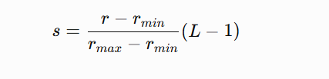
Contrast Stretching
Contrast stretching is used to increase the contrast of an image.
If the input intensity values are concentrated in a small range, contrast stretching spreads them over a larger range.
simple equation is:

Slide 8
where:
rmin​ = minimum input intensity
rmax​ = maximum input intensity
L = number of intensity levels
Effect
Dark pixels become darker.
Bright pixels become brighter.
Overall contrast increases.

Slide 9
Before stretching:
Input intensity
0 ──────── 50 ───────────── 150 ──────── 255
↑ ↑
minimum maximum

Slide 10
The image was using only 50 to 150, so the contrast was low.
After stretching:
Output intensity
0 ─────────────────────────────────────── 255
↑ ↑
50 becomes 0 150 becomes 255

Slide 11
So the range 50–150 is expanded to 0–255.
r = the current/input pixel value you want to transform.
Suppose:
Minimum intensity: rmin​=50
Maximum intensity: rmax​=150
Pixel value: r=100
8-bit image: L=256
Formula:

Slide 12
Put the values in the formula
s=150−50100−50​×(256−1)
First solve the top and bottom:
s=10050​×255 s=0.5×255 s=127.5​
Since pixel intensity must be an integer:
s≈128​
Therefore:
Input pixel = 100
Output pixel = 128

Slide 13
Gray-Level Slicing
Gray-level slicing is used to highlight a particular range of intensity values.
For example, suppose we want to highlight pixels between 100 and 150.
Input intensity
0 -------- 100 ======== 150 -------- 255
↑ ↑
selected range

Slide 14
Pixels between 100 and 150 can be made white, while other pixels can be made black.
Simple equation
s={255 100≤r≤150
0​​ otherwise
ffect
A particular object or region becomes clearly visible.
Applications
Highlighting tumors in medical images
Identifying roads in satellite images
Detecting objects with a particular intensity range

Slide 15
Bit-Plane Slicing
An image pixel can be represented using binary bits.
For an 8-bit image:
b7​b6​b5​b4​b3​b2​b1​b0​
Example:
150=(10010110)2​
Each bit represents one bit plane.
b7​ → most significant bit
b0​ → least significant bit

Slide 16
ffect
Higher bit planes contain the major information of the image, while lower bit planes contain finer details.
Applications
Image compression
Image enhancement
Image analysis

Slide 17
Thresholding
Thresholding converts a grayscale image into a binary image.
If threshold is T:
s={0 r<T
255​ r≥T​
If T=100:

Slide 18
Input Output
50 → 0
80 → 0
100 → 255
180 → 255

Slide 19
Effect
Separates the object from the background.
Applications
Document scanning
Object detection
Character recognition
Image segmentation

Slide 20
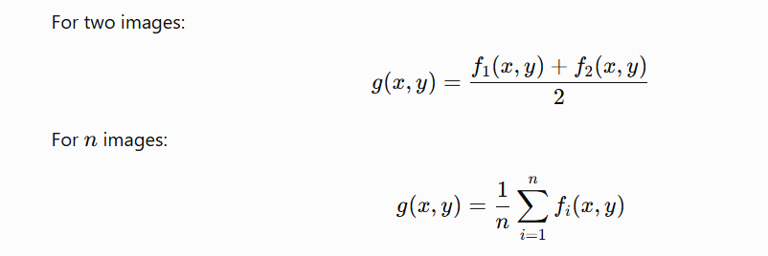
Image Averaging
Image averaging combines corresponding pixels from images.

Slide 21
Effect
Random noise is reduced.
Application
Noise reduction
Medical imaging
Astronomical images

Slide 22
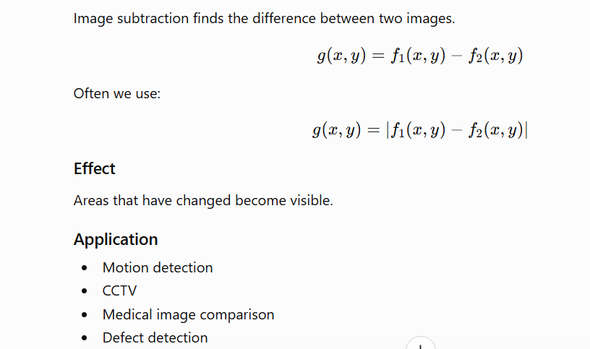
Image Subtraction

Slide 23
Complement / Negative Transformation
This changes black into white and white into black.
For an 8-bit image:
s=255−r
Input Output
0 → 255
50 → 205
100 → 155
255 → 0

Slide 24
Application
X-ray images
Highlighting details
Image enhancement

Slide 25
Gamma / Power-Law Transformation
Equation:
s=cr^γ
The value of γ controls brightness.
If γ<1
Image becomes brighter.
If γ>1
Image becomes darker.

Slide 26
Gamma < 1 → Bright image
Gamma = 1 → Original
Gamma > 1 → Dark image
Application
Display systems
Camera images
Brightness correction

Slide 27
Image Addition
Image addition means adding the pixel values of two images at the same position.
Formula
g(x,y)=f1​(x,y)+f2​(x,y)
Where:
f1​(x,y) = pixel value of first image
f2​(x,y) = pixel value of second image
g(x,y) = output pixel value

Slide 28
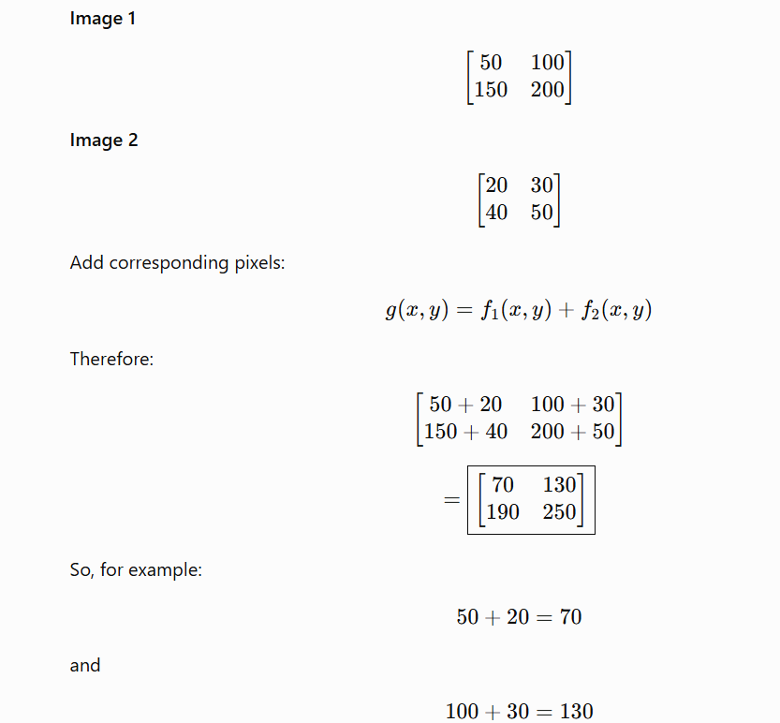

Slide 29
Image addition generally increases the brightness of the image.
If the result is greater than 255 for an 8-bit image, it is usually clipped to 255.
For example:
200+100=300
But an 8-bit image cannot store 300, so:
300→255​

Slide 30
Applications
Brightness adjustment
Combining two images
Noise reduction when multiple images are averaged
Image blending
Creating special effects
Addition increases intensity, while averaging is commonly used to reduce noise.

Slide 31
Translation, Rotation and Scaling
1. Translation
Translation means moving an image from one position to another.
Equation:
x′=x+tx​
y′=y+t
where tx​ and ty​ are the movement in x and y directions.y​

Slide 32
Suppose a pixel/object is at:
(x,y)=(2,3)
And we want to move it:
4 pixels to the right → tx​=4
2 pixels upward → ty​=2

Slide 33
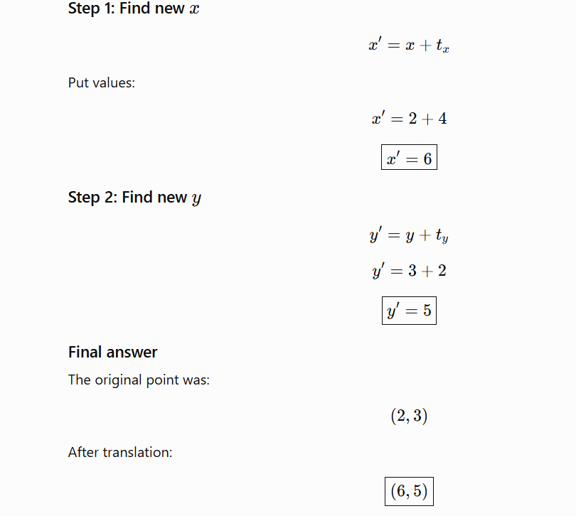

Slide 34
Before translation After translation
● (2,3) ● (6,5)
→ 4 pixels right
↑ 2 pixels up

Slide 35
Rotation Example
Rotation means turning an image/object around a point.
Formulas:
x′=xcosθ−ysinθ
y′=xsinθ+ycosθ
Example: Rotate a point by 90°

Slide 36
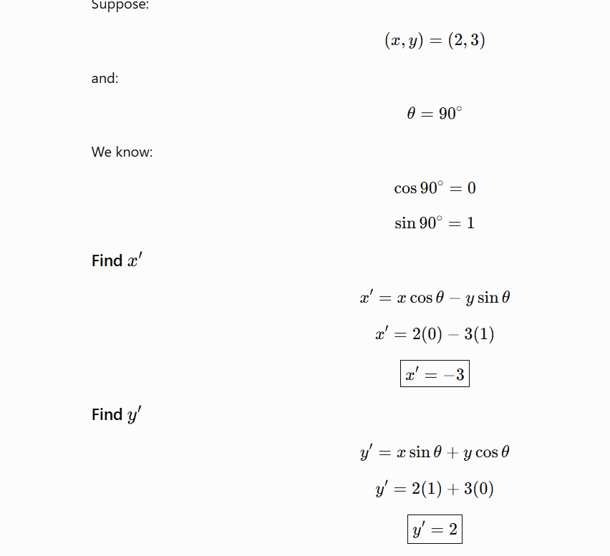

Slide 37
Final answer
Original point:
(2,3)
After 90° rotation:
(−3,2)​
Remember: Rotation changes the orientation/position, but not the size of the object.

Slide 38
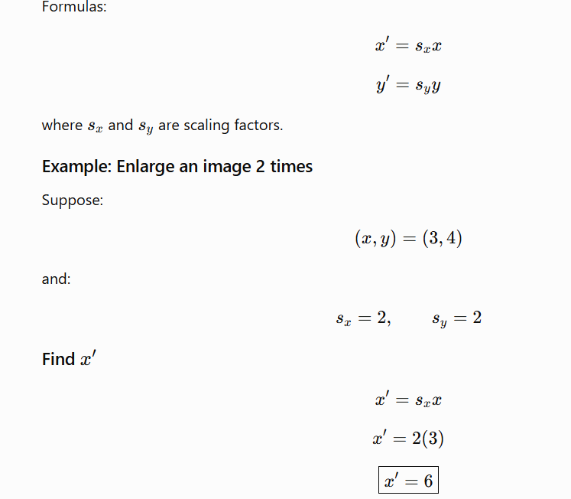
Scaling Example
Scaling means increasing or decreasing the size of an image/object.

Slide 39
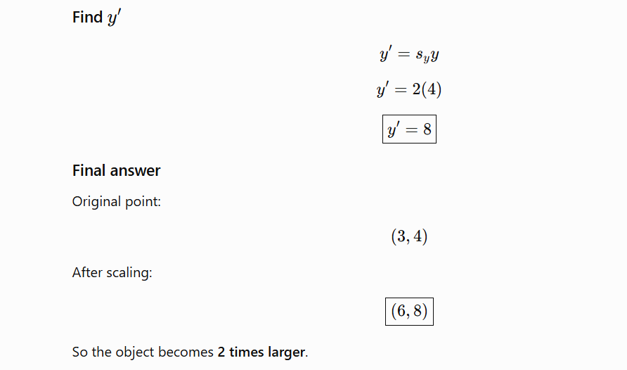

Slide 40
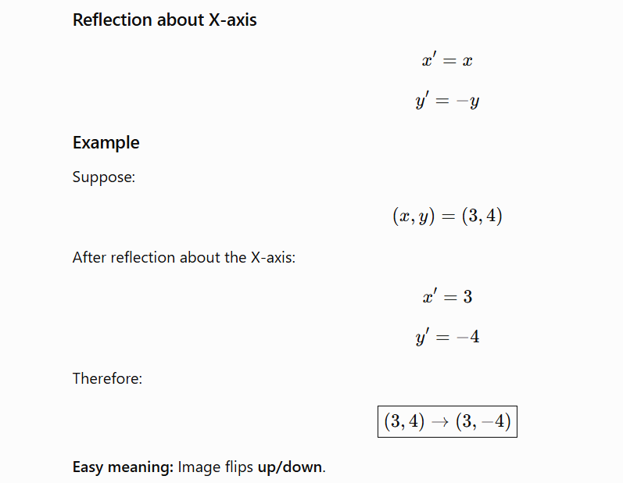
Reflection
Reflection means flipping an image like a mirror.
Reflection about X-axis

Slide 41
Spatial Resolution
Spatial resolution tells us how much detail an image can show.
It is mainly related to the number of pixels used to represent an image.
For example:
Low resolution
Very little detail can be seen.

Slide 42
High resolution
Much more detail can be represented.
Example
Compare:
640 × 480 → lower resolution
1920 × 1080 → higher resolution

Slide 43
Spatial resolution = ability of an image to show small details.
Application in computer vision
High spatial resolution is useful for:
Face recognition
Medical imaging
Number plate recognition
Object detection

Slide 44
Frequency
n image processing, frequency tells us how quickly the intensity changes across an image.
There are two important types:
Low frequency
Intensity changes slowly.
Example:
50 52 54 56 58

Slide 45
Values change gradually.
This usually represents:
Smooth regions
Background
Large objects
High frequency
Intensity changes quickly.

Slide 46
0 255 0 255 0
V alues change very quickly.
High frequencies are usually associated with:
Edges
Fine details
Noise
Low frequency = smooth areas
High frequency = edges and fine details

Slide 47
Wavelength
Wavelength is the distance between two similar points of a wave.
It is represented by:
λ
In electromagnetic waves, wavelength is important because different wavelengths correspond to different parts of the electromagnetic spectrum.

Slide 48
In computer vision, different wavelengths can be used to capture different types of information.
Visible light:
Used in normal cameras.
Helps us see color and objects.
Infrared:
Used in thermal cameras.
Can detect heat.
X-rays:
Used for medical imaging.
Can see structures inside the body.
The relationship between wave speed, frequency and wavelength is:

Slide 49
v=fλ
For electromagnetic waves:
c=fλ
where:
c = speed of light
f = frequency
λ = wavelength

Slide 50
Wavelength tells us the size/length of one cycle of an electromagnetic wave.
Intensity Slicing
Intensity slicing means highlighting pixels that have intensity values within a particular range.
In simple words:
We choose a range of brightness values and make those pixels stand out.

Slide 51
Suppose we have a grayscale image with values from 0 to 255.
We want to highlight pixels between:
100 and 150
So:
Pixels 100–150 → make them white (255)
Other pixels → make them black (0)

Slide 52
50 110 130
80 150 180
200 120 70
0 255 255
0 255 0
0 255 0
intensity slicing is a point processing technique in which a specific range of intensity values is selected and highlighted while other intensity values are suppressed or left unchanged.

Slide 53
INTODUCTION TO COMPUTER VISION
Computer vision is a subfield of artificial intelligence that deals with acquiring, processing, analyzing, and making sense of visual data such as digital images and videos.
It is one of the most compelling types of artificial intelligence that we regularly implement in our daily routines.
Computer vision helps to understand the complexity of the human vision system and trains computer systems to interpret and gain a high-level understanding of digital images or videos.

Slide 54
In the early days, developing a machine system having human-like intelligence was just a dream, but with the advancement of artificial intelligence and machine learning, it also became possible.
Computer vision is one of the most important fields of artificial intelligence (AI) and computer science engineering that makes computer systems capable of extracting meaningful information from visual data like videos and images.
Further, it also helps to take appropriate actions and make recommendations based on the extracted information.

Slide 55
How does Computer Vision Work?
Computer vision is a technique that extracts information from visual data, such as images and videos. Although computer vision works similarly to human eyes with brain work, this is probably one of the biggest open questions for IT professionals: How does the human brain operate and solve visual object recognition?

Slide 56
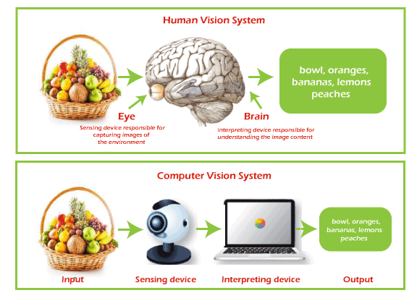

Slide 57
On a certain level, computer vision is all about pattern recognition which includes the training process of machine systems for understanding the visual data such as images and videos, etc.
a vast amount of visual labeled data is provided to machines to train it. This labeled data enables the machine to analyze different patterns in all the data points and can relate to those labels.
E.g., suppose we provide visual data of millions of dog images. In that case, the computer learns from this data, analyzes each photo, shape, the distance between each shape, color, etc., and hence identifies patterns similar to dogs and generates a model.
As a result, this computer vision model can now accurately detect whether the image contains a dog or not for each input image.

Slide 58
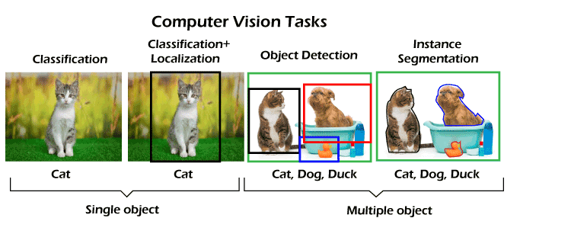
Task Associated with Computer Vision
Although computer vision has been utilized in so many fields, there are a few common tasks for computer vision systems. These tasks are given below:

Slide 59
Applications of computer vision
Facial recognition: Computer vision has enabled machines to detect face images of people to verify their identity. Initially, the machines are given input data images in which computer vision algorithms detect facial features and compare them with databases of fake profiles. Popular social media platforms like Facebook also use facial recognition to detect and tag users. Further, various government spy agencies are employing this feature to identify criminals in video feeds.

Slide 60
Healthcare and Medicine: Computer vision has played an important role in the healthcare and medicine industry. Traditional approaches for evaluating cancerous tumors are time-consuming and have less accurate predictions, whereas computer vision technology provides faster and more accurate chemotherapy response assessments; doctors can identify cancer patients who need faster surgery with life-saving precision.
Self-driving vehicles: Computer vision technology has also contributed to its role in self-driving vehicles to make sense of their surroundings by capturing video from different angles around the car and then introducing it into the software. This helps to detect other cars and objects, read traffic signals, pedestrian paths, etc., and safely drive its passengers to their destination.

Slide 61
Optical character recognition (OCR)
Optical character recognition helps us extract printed or handwritten text from visual data such as images. Further, it also enables us to extract text from documents like invoices, bills, articles, etc.
Retail (e.g., automated checkouts): Computer vision is also being implemented in the retail industries to track products, shelves, wages, record product movements into the store, etc. This AI-based computer vision technique automatically charges the customer for the marked products upon checkout from the retail stores.

Slide 62
Medical imaging: Computer vision helps medical professionals make better decisions regarding treating patients by developing visualization of specific body parts such as organs and tissues. It helps them get more accurate diagnoses and a better patient care system. E.g., Computed Tomography (CT) or Magnetic Resonance Imaging (MRI) scanner to diagnose pathologies or guide medical interventions such as surgical planning or for research purposes.
Automotive safety: Computer vision has added an important safety feature in automotive industries. E.g., if a vehicle is taught to detect objects and dangers, it could prevent an accident and save thousands of lives and property.

Slide 63
Fingerprint recognition and biometrics: Computer vision technology detects fingerprints and biometrics to validate a user's identity. Biometrics deals with recognizing persons based on physiological characteristics, such as the face, fingerprint, vascular pattern, or iris, and behavioral traits, such as gait or speech. It combines Computer Vision with knowledge of human physiology and behavior.
Surveillance: It is one of computer vision technology's most important and beneficial use cases. Nowadays, CCTV cameras are almost fitted in every place, such as streets, roads, highways, shops, stores, etc., to spot various doubtful or criminal activities. It helps provide live footage of public places to identify suspicious behavior, identify dangerous objects, and prevent crimes by maintaining law and order.

Slide 64
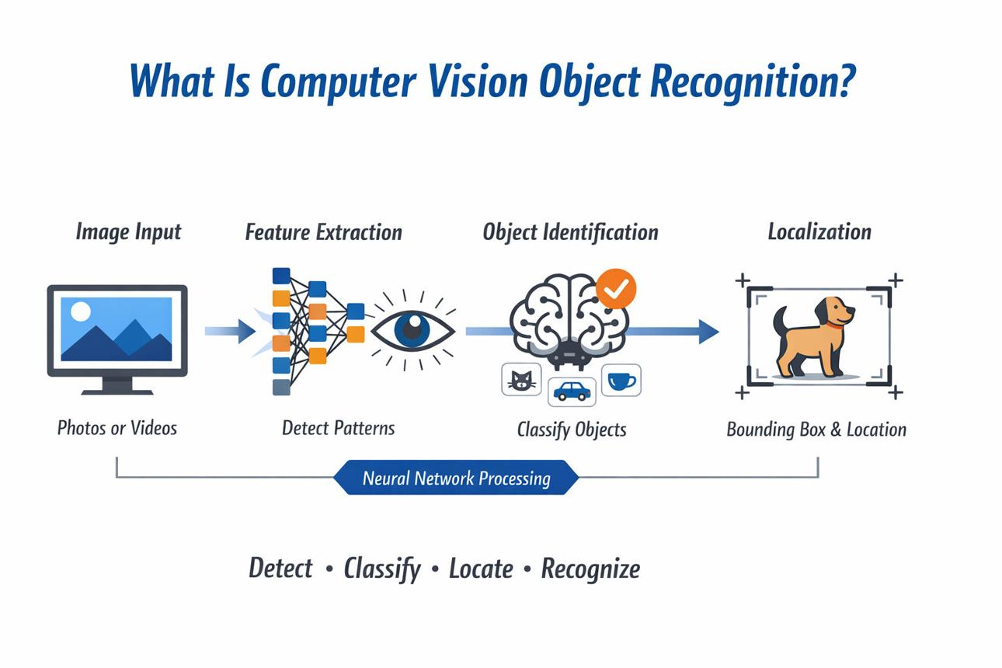

Slide 65
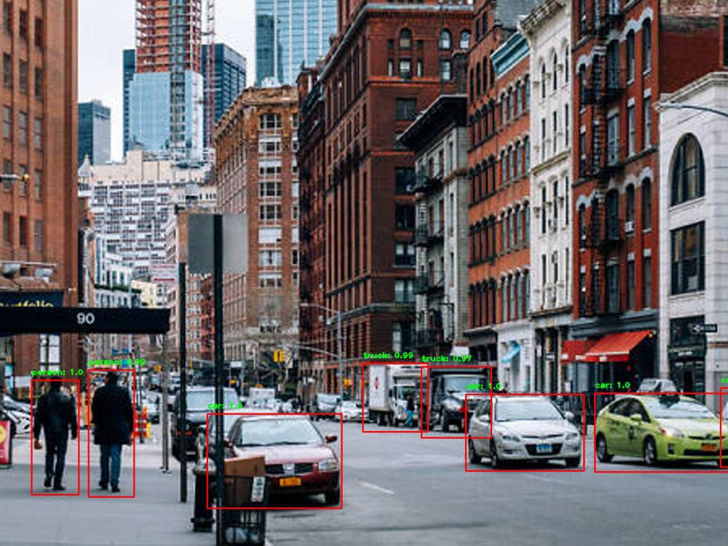

Slide 66
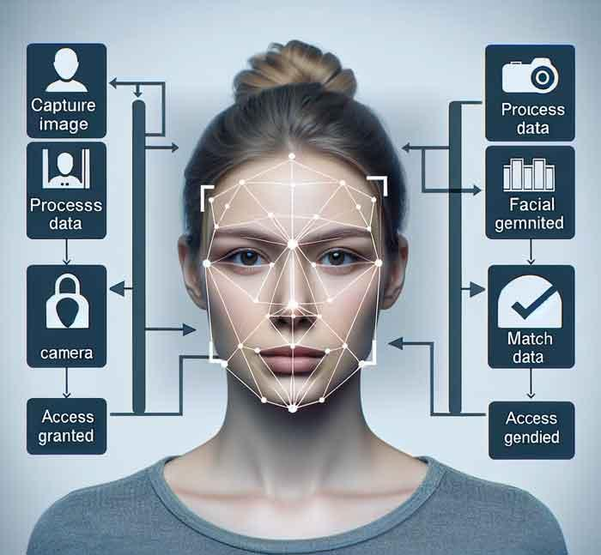

Slide 67
The basic steps are:
Image Capture A camera captures an image or video.
The image is made up of tiny dots called pixels.
Preprocessing The computer cleans the image (removes noise, adjusts brightness, resizes, etc.).
This helps improve accuracy.
Feature Extraction The system looks for important patterns such as:
  Edges
  Shapes
  Colors
  Textures

Slide 68
Analysis with AI Models Machine learning or deep learning models analyze the features.
The model compares what it sees with patterns learned from thousands or millions of training images.
Decision/Prediction The system outputs a result, such as:
  "This is a cat."
  "There is a pedestrian ahead."
  "The face belongs to John."

Slide 69
Example: Cat vs. Dog Classification
Suppose you want a computer to identify whether a picture contains a cat or a dog.
Collect thousands of labeled images:
  Cat images → labeled "Cat"
  Dog images → labeled "Dog"
Train a deep learning model (such as a Convolutional Neural Network).
During training, the model learns:
  Cats usually have certain ear shapes, facial structures, and body patterns.
  Dogs have different features.
When a new image is provided:
Input Image → AI Model → Output: "Dog (98% confidence)"

Slide 70
DIGITAL IMAGE PROCESSING
Digital Image Processing (DIP) is the use of computer algorithms to manipulate, analyze, enhance, and interpret digital images. It is a branch of computer science, signal processing, and artificial intelligence that converts images into digital form and performs operations on them to improve quality or extract useful information.

Slide 71
What Is a Digital Image?
A digital image is a two-dimensional array of pixels (picture elements).
Each pixel contains intensity or color information.
Images are stored as matrices.
The value of each pixel represents brightness or color.

Slide 72
120 | 125 | 130
118 | 122 | 128
115 | 120 | 126
Each number represents the brightness of a pixel.
0 = Black
255 = White
Values in between represent shades of gray.

Slide 73
Components of Digital Image Processing
A. Image Acquisition
This is the first step.
Process:
Capture image using camera/scanner.
Convert it into digital format.
Store pixel values.
Example:
Mobile phone camera captures a photo.
The photo is converted into a matrix of pixels.

Slide 74
B. Image Enhancement
Improves image quality for human viewing.
Techniques:
Brightness adjustment
Contrast enhancement
Sharpening
Noise removal
Example:
Improving a dark photograph.
Making an X-ray easier to view.

Slide 75
C. Image Restoration
Restores a degraded image using mathematical models.
Problems corrected:
Blur
Motion distortion
Camera shake
Noise
Example:
Restoring old photographs.
Removing motion blur from CCTV footage.

Slide 76
D. Image Compression
Reduces image storage size.
Types:
Lossless Compression
No information is lost.
Examples:
PNG
TIFF
Lossy Compression
Some information is removed.
Examples:
JPEG
WebP
Benefits:
Faster transmission
Less storage requirement

Slide 77
E. Image Segmentation
Divides an image into meaningful regions.
Purpose:
Identify objects
Separate foreground from background
Example:
Detecting tumors in MRI scans.
Identifying vehicles in traffic images.

Slide 78
F. Image Representation and Description
After segmentation:
Represent object boundaries.
Extract object features.
Features include:
Shape
Area
Texture
Color
Example:
Face recognition systems extract facial features.

Slide 79
G. Object Recognition
Identifies objects present in an image.
Examples:
Face detection
Vehicle detection
Fingerprint recognition
License plate recognition
Modern systems use:
Machine Learning
Deep Learning
Convolutional Neural Networks (CNNs)

Slide 80
Fundamental Steps in Digital Image Processing
Image Acquisition
↓
Preprocessing
↓
Enhancement
↓
Segmentation
↓
Feature Extraction
↓
Recognition & Interpretation

Slide 81
Image Types
A. Binary Image
Contains only two pixel values:
0 = Black
1 = White
Example:
1 1 0
0 1 1
1 0 0

Slide 82
B. Grayscale Image
Contains intensity values:
0–255
Example:
X-ray images
Black-and-white photos

Slide 83
C. Color Image
Uses RGB channels.
Each pixel has:
Red
Green
Blue
Example:
Pixel = (255,0,0)
Represents pure red color.

Slide 84
5. Image Processing Levels
Low-Level Processing
Input: Image
Output: Image
Examples:
Noise removal
Contrast enhancement

Slide 85
Mid-Level Processing
Input: Image
Output: Features
Examples:
Segmentation
Edge detection
High-Level Processing
Input: Features
Output: Knowledge
Examples:
Face recognition
Medical diagnosis

Slide 86
Common Operations in Digital Image Processing
Image Smoothing
Reduces noise.
Methods:
Mean Filter
Gaussian Filter
Median Filter
Example:
Removing grainy appearance from photographs.

Slide 87
Image Sharpening
Highlights edges and details.
Methods:
Laplacian Filter
High-Pass Filter
Example:
Improving satellite images.

Slide 88
Edge Detection
Detects boundaries of objects.
Popular operators:
Sobel
Prewitt
Canny
Example:
Finding outlines of cars in traffic footage.

Slide 89
Thresholding
Converts grayscale image into binary image.
If Pixel > Threshold → White
Else → Black

Slide 90
Image Transformations
255 255 255
255 0 255
255 255 255
The middle pixel is black and all others are white:

Slide 91
(255,0,0) → Red
(0,255,0) → Green
(0,0,255) → Blue
(255,255,0) → Yellow
A 2×2 color image might be:
[(255,0,0), (0,255,0)]
[(0,0,255), (255,255,255)]
🟥 🟩
🟦 ⬜

Slide 92
HOW 3D IMAGES CONVERTED TO 2D
A 3D image (or 3D object) is converted into a 2D image through a process called projection. This is exactly how a camera, the human eye, or a computer graphics system works: a three-dimensional scene is projected onto a two-dimensional surface (camera sensor, screen, or retina).
Imagine a cube in space:

Slide 93
z
|
|
|
O------ y
/
/
x

Slide 94
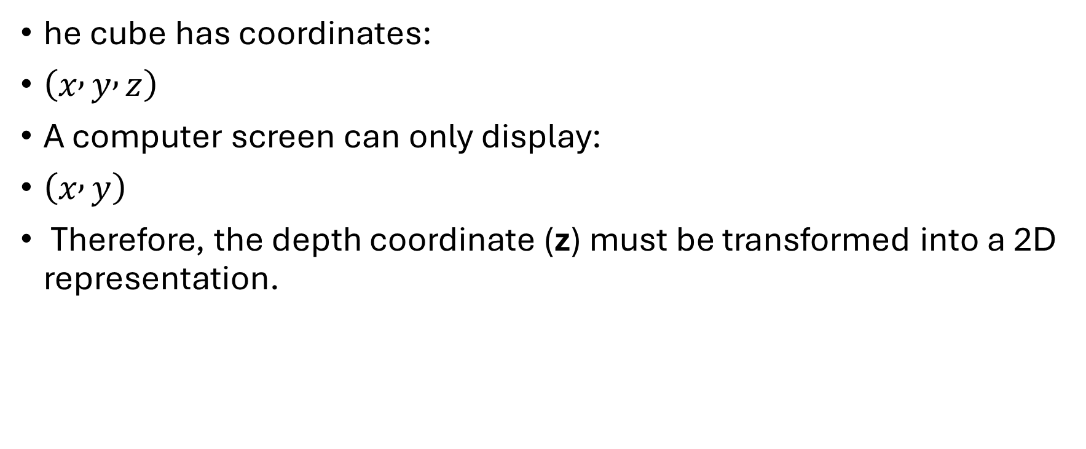
he cube has coordinates:
$\left(x , y , z\right)$
A computer screen can only display:
$\left(x , y\right)$
Therefore, the depth coordinate (z) must be transformed into a 2D representation.

Slide 95
Steps in 3D to 2D Conversion
1. Model the 3D Object
The object is represented by vertices:
P1 = (x1,y1,z1)
P2 = (x2,y2,z2)
P3 = (x3,y3,z3)
...
For example:
A = (2,3,5)
B = (4,1,8)

Slide 96
2. Position the Camera
A virtual camera is placed in the 3D scene.
The camera has:
Position
Direction
Viewing angle

Slide 97
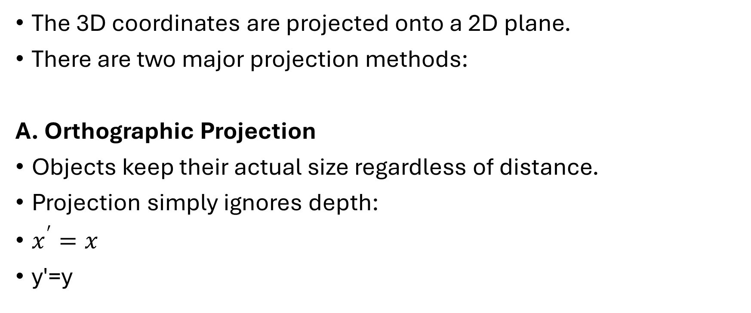
3. Projection
The 3D coordinates are projected onto a 2D plane.
There are two major projection methods:
A. Orthographic Projection
Objects keep their actual size regardless of distance.
Projection simply ignores depth:
$x^{′}=x$
y′=y

Slide 98
3D Point: (5,4,10)
2D Point: (5,4)
Used in:
Engineering drawings
Blueprints
B. Perspective Projection
This is how human vision and cameras work.
Farther objects appear smaller.
Show a 3D object on a flat screen.
The projection equations are:

Slide 99
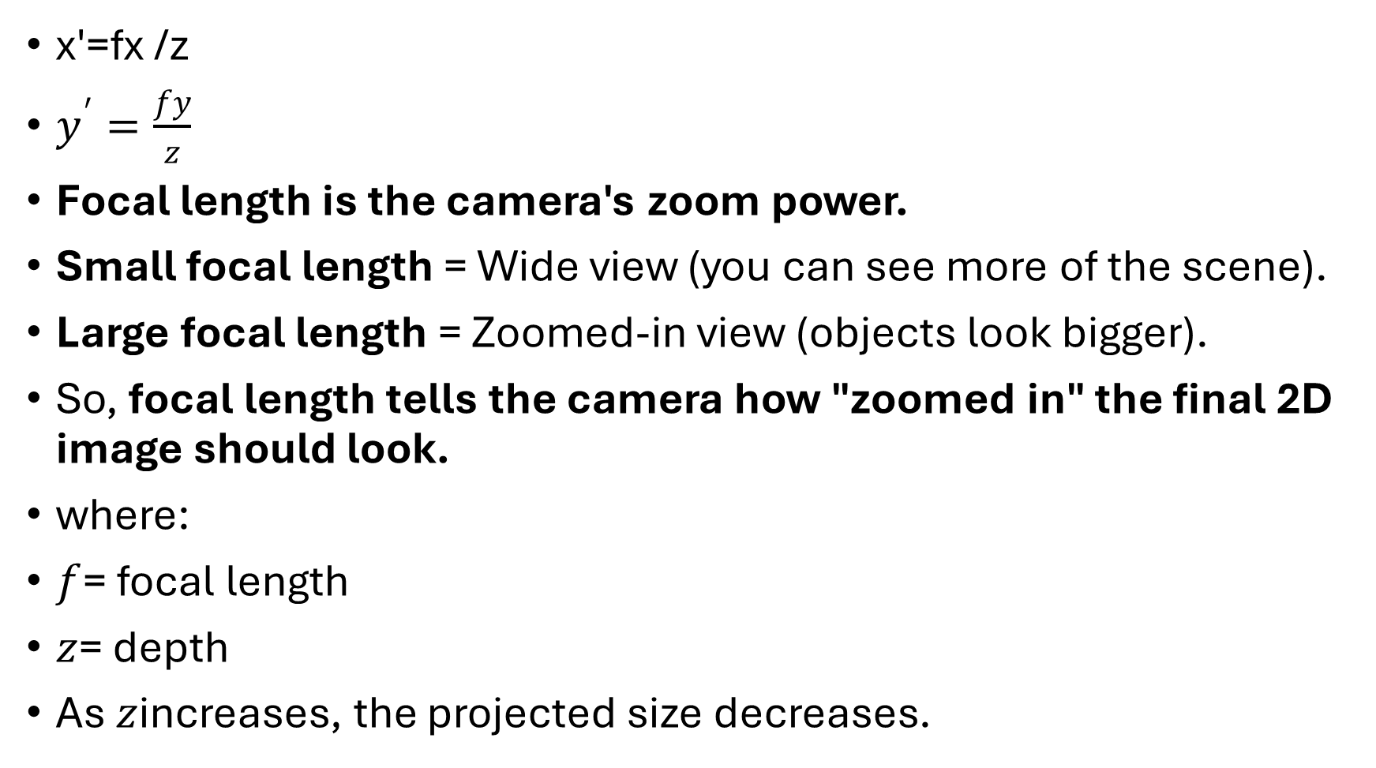
x′=fx​ /z
$y^{′}=\frac{fy}{z}$
Focal length is the camera's zoom power.
Small focal length = Wide view (you can see more of the scene).
Large focal length = Zoomed-in view (objects look bigger).
So, focal length tells the camera how "zoomed in" the final 2D image should look.
where:
$f$= focal length
$z$= depth
As $z$increases, the projected size decreases.

Slide 100

Suppose:
Point = (4, 6, 2)
f = 1
Then:
$x^{′}=\frac{4}{2}=2$
$y^{′}=\frac{6}{2}=3$
Projected point:
(2,3)

Slide 101
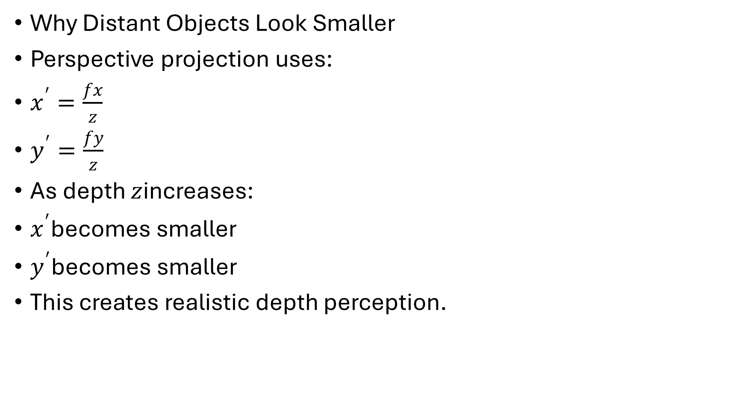
Why Distant Objects Look Smaller
Perspective projection uses:
$x^{′}=\frac{fx}{z}$
$y^{′}=\frac{fy}{z}$
As depth $z$increases:
$x^{′}$becomes smaller
$y^{′}$becomes smaller
This creates realistic depth perception.

Slide 102
3D Point | Projected 2D Point
(10,10,2) | (5,5)
(10,10,10) | (1,1)

Slide 103
4. Hidden Surface Removal
After projection, some surfaces may be hidden behind others.
Algorithms used:
Z-buffer
Depth buffer
Painter's algorithm
These ensure only visible surfaces appear in the final image.

Slide 104
5. Rendering
The final 2D image is created by:
Coloring pixels
Adding textures
Lighting
Shadows
Reflections
This process is called rendering.

Slide 105
3D Model
↓
Projection
↓
Visible Surfaces
↓
Lighting
↓
2D Image

Slide 106
Image Formation Models in Computer Vision
Image formation is the process by which a 3D real-world scene is converted into a 2D digital image. Every image captured by a camera is the result of:
Light emission from a source
Light interacting with objects
Reflection from object surfaces
Projection through a camera
Recording by an image sensor

Slide 107
What is Image Formation?
Image formation is the process by which a real object becomes a picture inside a camera.
Example: Taking a Photo of an Apple
Sunlight falls on the apple.
The apple reflects light.
The camera receives that reflected light.
The camera sensor records it.
A digital image is created.

Slide 108
1. Monocular Imaging System
A monocular imaging system uses only one camera to observe a scene.
Human Eye Analogy
A monocular camera works similarly to one human eye:
Human Eye | Camera
Retina | Image Sensor
Pupil | Aperture
Lens | Camera Lens
Brain | Computer Vision Algorithm

Slide 109
Components of a Monocular Camera
1. Lens
Collects light from the scene.
2. Aperture
Controls amount of light entering.
3. Image Sensor
Converts light into electrical signals.
4. Processor
Creates the digital image.

Slide 110
Example:
Imagine two cars:
Car A is 5 meters away.
Car B is 50 meters away.
In the image:
Car A looks large.
Car B looks small.
Even though both cars may be the same size.
This happens because the camera uses perspective projection.

Slide 111
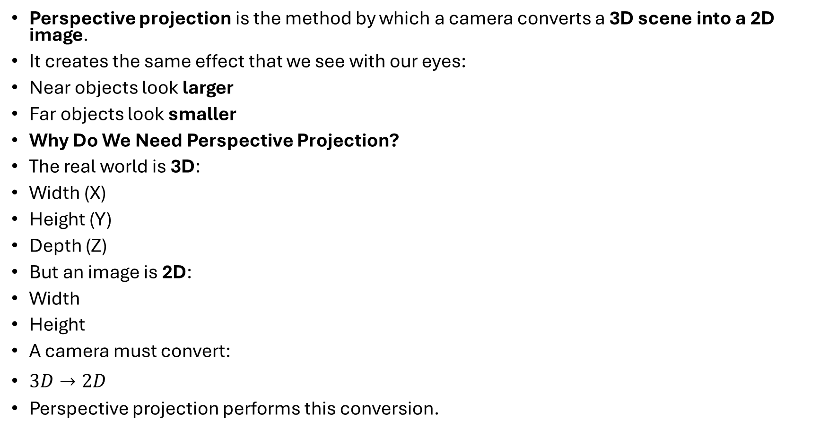
Perspective projection is the method by which a camera converts a 3D scene into a 2D image.
It creates the same effect that we see with our eyes:
Near objects look larger
Far objects look smaller
Why Do We Need Perspective Projection?
The real world is 3D:
Width (X)
Height (Y)
Depth (Z)
But an image is 2D:
Width
Height
A camera must convert:
$3D→2D$
Perspective projection performs this conversion.

Slide 112
A Monocular Imaging System is a vision system that uses one camera to capture images of the world.
Mono = One
Ocular = Eye
So, monocular means one eye or single camera.

Slide 113
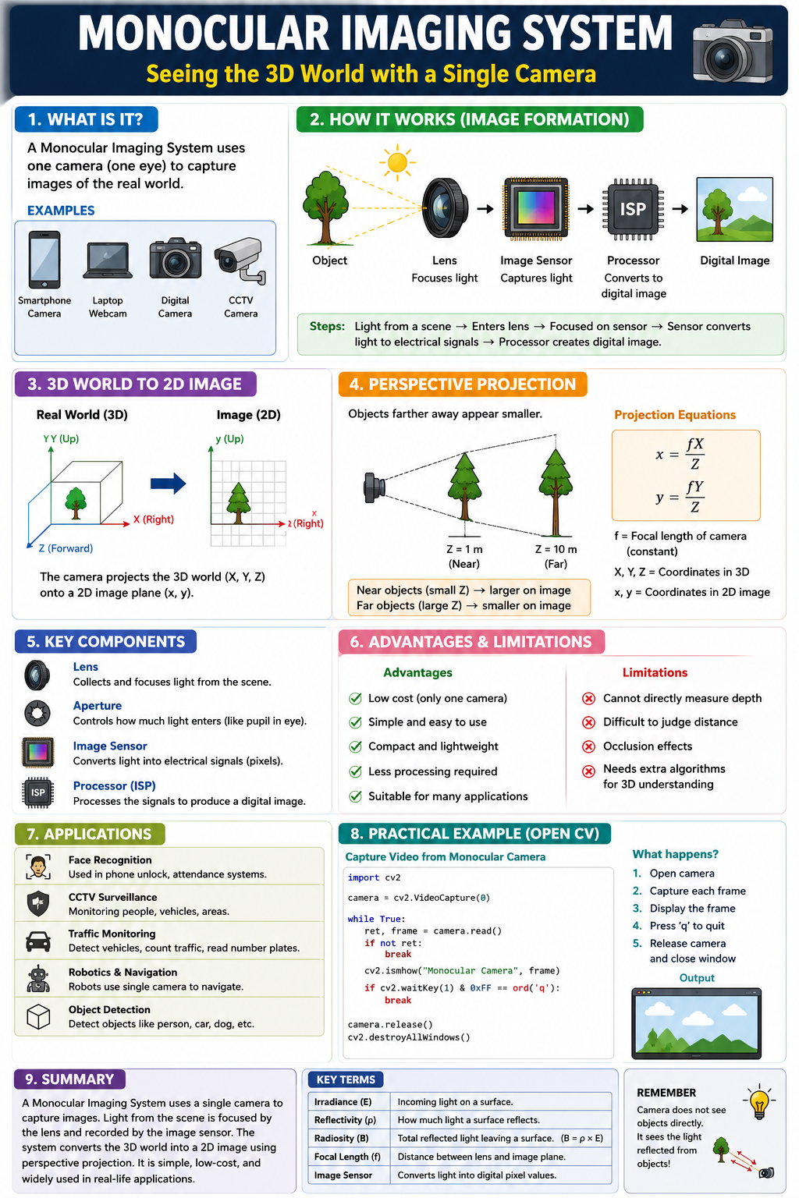

Slide 114
2. Why is it Important?
Computer Vision systems need images to understand the world.
Before a computer can:
Detect faces
Recognize objects
Read number plates
Count people
It must first capture an image.
A monocular camera is often the first step.

Slide 115
How Does a Monocular Imaging System Work?
Imagine taking a photo of an apple.
Sunlight
↓
Apple
↓ (reflected light)
Camera Lens
↓
Image Sensor
↓
Digital Image

Slide 116
Step 1: Light Source
The Sun or a bulb produces light.
Step 2: Object Reflects Light
The apple reflects some of the incoming light.
For a red apple:
Reflects red light
Absorbs many other colors
Step 3: Light Enters the Camera
The reflected light enters the camera lens.
Step 4: Lens Focuses the Light
The lens bends the light rays and focuses them onto the sensor.

Slide 117
Step 5: Sensor Records the Image
The image sensor converts light into digital values called pixels.
Step 6: Computer Creates the Image
Millions of pixels are combined to form the final image.
Components of a Monocular Imaging System
A) Lens
The lens collects and focuses light.
Example
Like spectacles help your eyes focus, the camera lens focuses light onto the sensor.

Slide 118
B) Aperture
The aperture controls how much light enters.
Example
Bright day → small aperture
Dark room → large aperture
It works like the pupil of the human eye.
C) Image Sensor
The sensor captures light.
Common types:
CCD
CMOS
Every smartphone camera contains a CMOS sensor.

Slide 119
D) Processor
The processor converts sensor data into a digital image.
Monocular Camera Sees a 3D World
The real world has:
  Width (X)
  Height (Y)
  Depth (Z)
3D World
(X, Y, Z)

Slide 120
But the image has only:
  Width
  Height
Therefore:
3D → 2D
This conversion is called projection.
Perspective Projection
Imagine two identical cars.
Car A = 5 meters away
Car B = 50 meters away

Slide 121
In reality:
Both cars are the same size.
In the image:
Car A looks large
Car B looks small
Why?
Because of perspective projection.
Easy Rule
Near objects appear bigger.
Far objects appear smaller.

Slide 122
Radiosity: The "Physics" of Image Formation
Radiosity is one of the concepts used to explain how light interacts with objects before an image is formed.
In simple words:
Radiosity is the total amount of light leaving a surface after it receives light.
It helps us understand why objects appear bright, dark, or colored in an image.

Slide 123
Why Do We Need Radiosity?
Imagine you take a photo of a room
he camera does not see the objects directly.
Instead:
A light source (Sun, bulb) emits light.
Light falls on objects.
Objects reflect light.
Reflected light reaches the camera.
The camera forms an image.
Radiosity describes how much light leaves the object after reflection.

Slide 124
Suppose a lamp shines on a white wall.
Lamp
↓
White Wall
↓
Light reflected in all directions
The wall receives light and reflects most of it.
The total reflected light leaving the wall is called radiosity.
In simple words, it is the total brightness coming off a surface that your eyes can see.

Slide 125
Suppose the same bulb shines on two walls.
White Wall
Receives 100 units of light.
Reflects 90 units.
High radiosity.
Therefore:
Wall appears bright.
Black Wall
Receives 100 units of light.
Reflects only 10 units.
Low radiosity.
Therefore:
Wall appears dark.

Slide 126
Sunlight falls on a red apple.
Sunlight contains:
Red light
Green light
Blue light
The apple:
Reflects most red light.
Absorbs much of the green and blue light.
  Sunlight
  ↓
  Red Apple
  ↓
  Mostly Red Light

Slide 127
The reflected light leaving the apple contributes to its radiosity.
That is why the camera sees the apple as red.
Radiosity in Image Formation
Image formation process:
  Light Source
  ↓
  Object Surface
  ↓
  Reflected Light (Radiosity)
  ↓
  Camera
  ↓
  Image

Slide 128
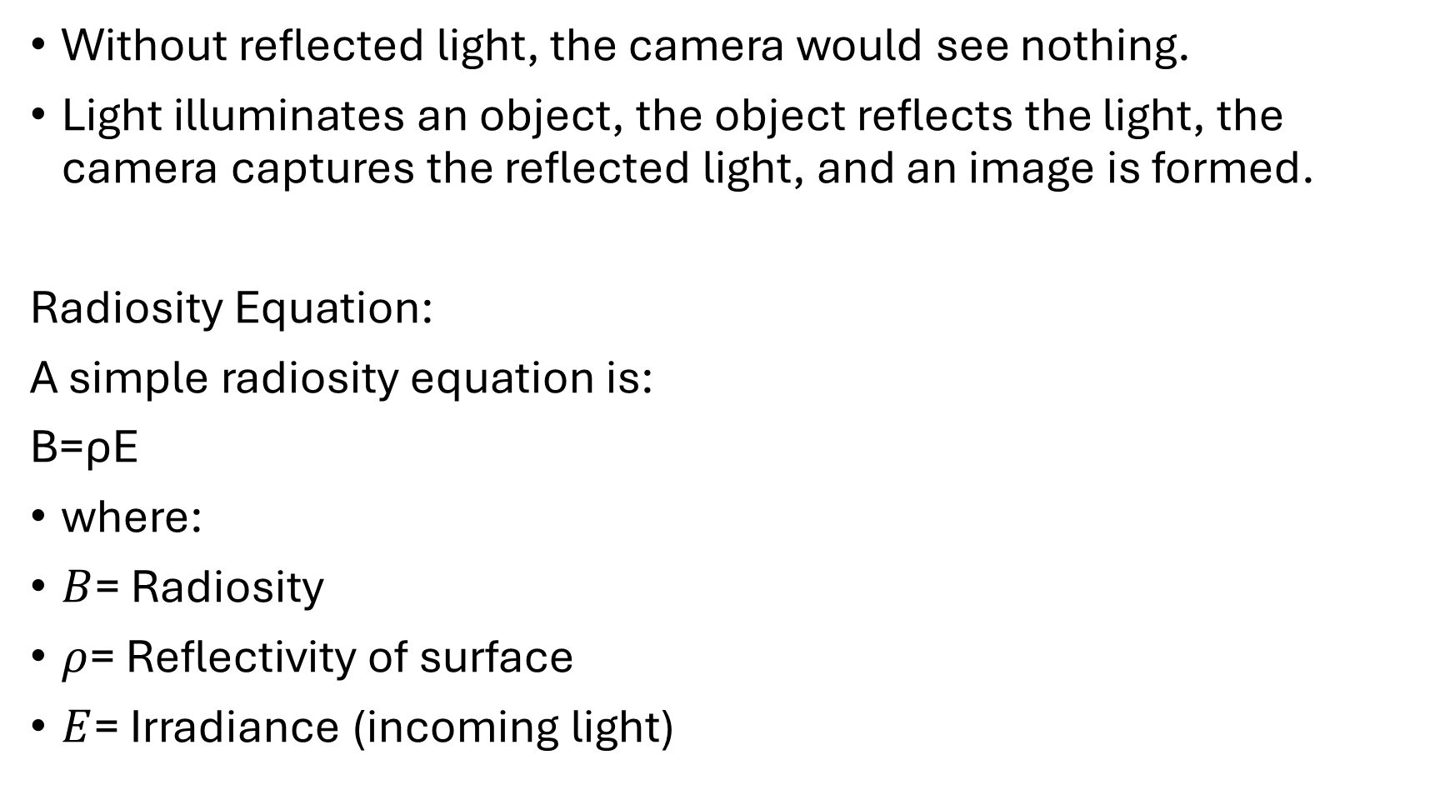
Without reflected light, the camera would see nothing.
Light illuminates an object, the object reflects the light, the camera captures the reflected light, and an image is formed.
Radiosity Equation:
A simple radiosity equation is:
B=ρE
where:
$B$= Radiosity
$ρ$= Reflectivity of surface
$E$= Irradiance (incoming light)

Slide 129
Understanding Each Term
1. Irradiance (E)
Irradiance means:
How much light falls on the surface.
Example
A lamp shines on a wall.
E=100
This means 100 units of light arrive at the wall.

Slide 130
2. Reflectivity (ρ)
Reflectivity tells us:
What fraction of the incoming light is reflected.
Its value is between 0 and 1.
ρ=0.8
means:
80% of light is reflected.
20% is absorbed.

Slide 131
3. Radiosity (B)
Radiosity means:
Total reflected light leaving the surface.
This is the light that travels to:
Your eyes
A camera

Slide 132

Example : White Wall
Incoming light:
$E=100$
Reflectivity:
$ρ=0.9$
Using:
$B=ρE$
$B=0.9×100$
$B=90$
Result
100 units arrive
90 units leave

Slide 133
A camera only sees the reflected light.
Radiosity vs Irradiance
Irradiance
Light arriving at a surface.
  Sun
  ↓
  Wall
Incoming light.

Slide 134
Radiosity
Light leaving the surface.
  Wall
  ↓
  Reflected Light
  Outgoing light.
Easy Trick
Irradiance = In
Radiosity = Out

Slide 135
Why Is Radiosity Important in Computer Vision?
Computer vision systems analyze images.
Images depend on:
Lighting conditions
Surface properties
Reflected light

Slide 136
Radiosity helps explain:
  Why objects look bright or dark.
  Why shadows appear.
  Why colors are visible.
  How realistic images are formed.

Slide 137
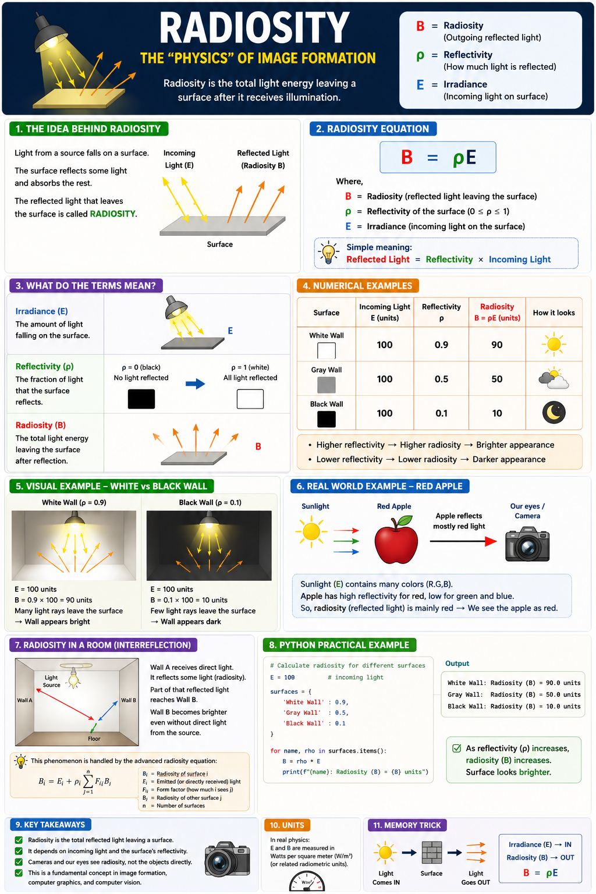

Slide 138
Radiance, Irradiance, BRDF, and Color
These concepts explain how light travels, reflects, and finally forms an image in a camera.
  Sun/Bulb
  ↓
  Irradiance (light falls on object)
  ↓
  BRDF (object reflects light)
  ↓
  Radiance (light leaves object)
  ↓
  Camera
  ↓
  Color Image

Slide 139
1. Irradiance (E)
Simple Definition
Irradiance is the amount of light falling on a surface.
Light Coming IN
Suppose sunlight falls on a table.
The light reaching the table is called irradiance.

Slide 140
Everyday Example
Sunny Day
A lot of sunlight falls on the road.
High irradiance.
Cloudy Day
Less sunlight falls on the road.
Low irradiance.
Therefore the road looks darker.

Slide 141
. Radiance (L)
Simple Definition
Radiance is the amount of light leaving a surface in a particular direction.
Think:
Light Going OUT toward the camera or your eyes.
Your camera captures only the light traveling toward it.
That light is called radiance.

Slide 142
Suppose a red apple is on a table.
  Sun
  ↓
  Apple
  ↓
  Camera
The light reflected from the apple toward the camera is radiance.

Slide 143
Irradiance | Radiance
Incoming light | Outgoing light
Falls on object | Leaves object
Before reflection | After reflection

Slide 144
BRDF (Bidirectional Reflectance Distribution Function)
BRDF describes how a surface reflects light.
Different materials reflect light differently.
Light
↓
Mirror
↓
Reflection in one direction
Mirror reflects light strongly in a specific direction.

Slide 145
White Wall
A wall spreads light in many directions.
Car Paint
Partly scattered and partly shiny.

Slide 146
Why BRDF Is Important
BRDF tells the computer:
Is this a mirror?
Is this metal?
Is this plastic?
Is this paper?
Different materials have different BRDFs.

Slide 147
Types of Reflection (BRDF Examples)
Diffuse Reflection
Light scatters in all directions.
Example
Chalk
White paper
Wall

Slide 148
B. Specular Reflection
Mirror-like reflection.
Example
Mirror
Glass
Polished steel

Slide 149
C. Glossy Reflection
Between diffuse and specular.
Example
Car paint
Plastic
Produces shiny spots.

Slide 150
Color Formation
Why Do Objects Have Color?
Objects reflect some colors and absorb others.
Example: Red Apple
The apple:
Reflects red
Absorbs green
Absorbs blue
Therefore:
We see red.

Slide 151
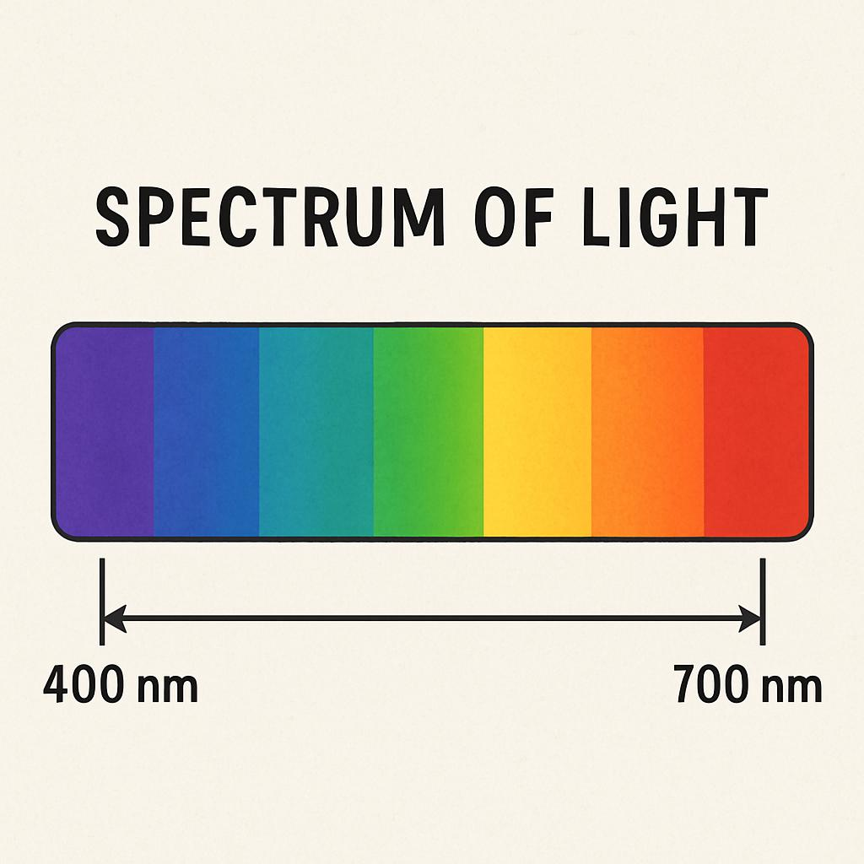

Slide 152
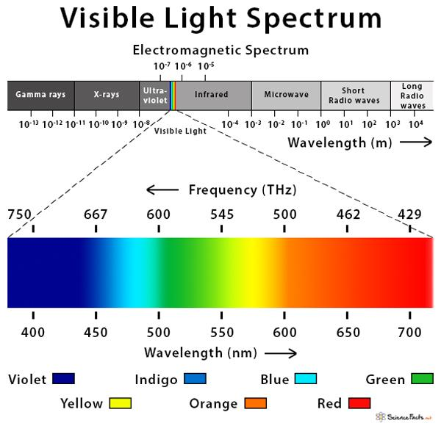

Slide 153
Color | Approx. Wavelength
Violet | 400 nm
Blue | 450 nm
Green | 550 nm
Yellow | 580 nm
Orange | 620 nm
Red | 700 nm

Slide 154
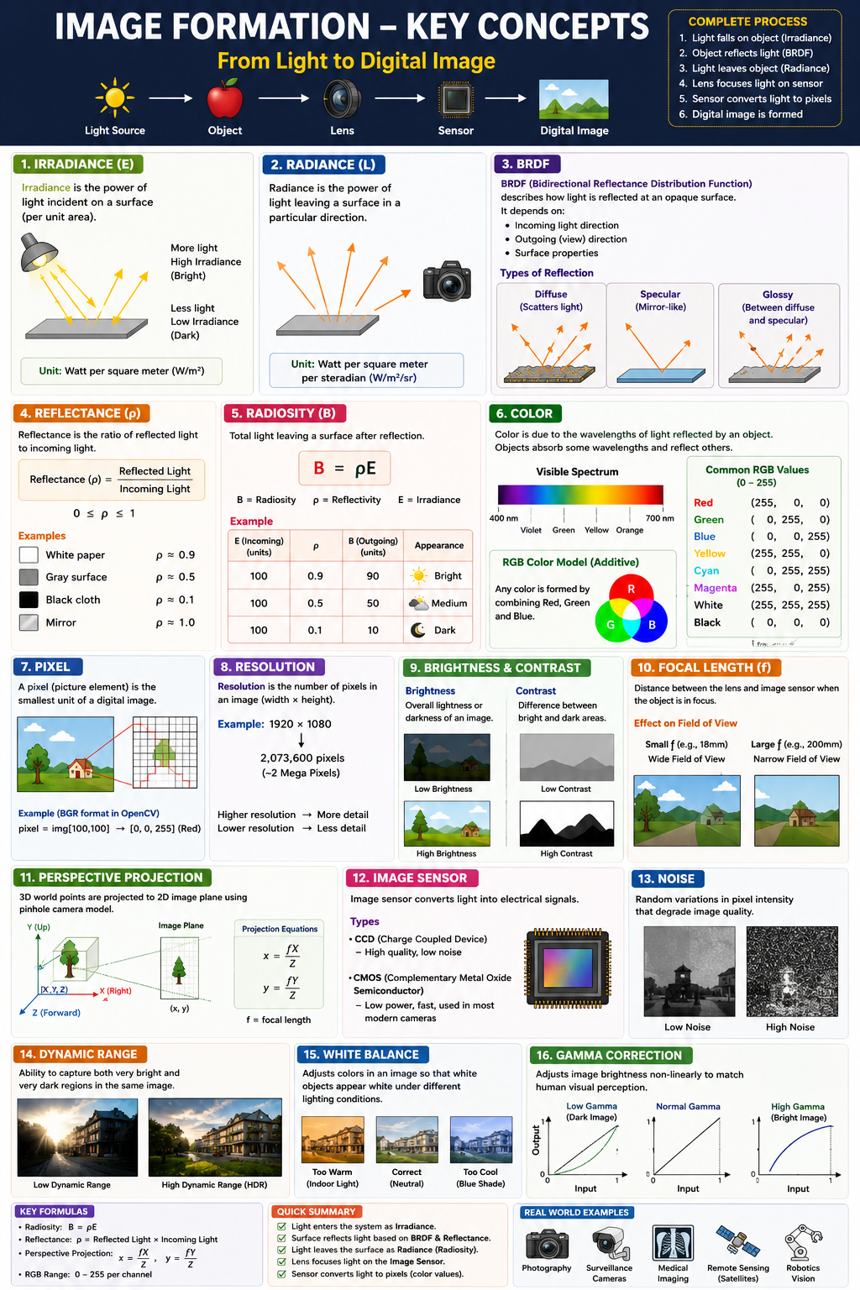

Slide 155
Orthographic Projection
Orthographic projection is a method of converting a 3D object into a 2D image where:
Object size does not change with distance
Parallel lines remain parallel (If two lines are parallel in the real world, they stay parallel in the image).
No depth effect is visible (You cannot easily tell which object is closer or farther. The image looks flat)

Slide 156
In orthographic projection, near and far objects appear the same size.
Imagine looking at a building from very, very far away using a powerful zoom lens.
Imagine looking at a building from very, very far away using a powerful zoom lens.
The depth differences become negligible, and the building looks "flat.“
This is close to orthographic projection.

Slide 157
How It Works
In orthographic projection, all projection rays are parallel.
Every point is projected straight.
Example:
Suppose there are two identical cubes.
Cube A = 2 m away
Cube B = 20 m away

Slide 158
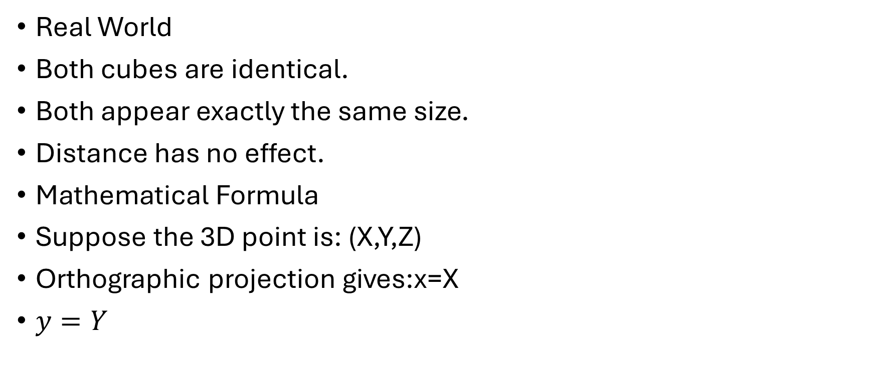
Real World
Both cubes are identical.
Both appear exactly the same size.
Distance has no effect.
Mathematical Formula
Suppose the 3D point is: (X,Y,Z)
Orthographic projection gives:x=X
$y=Y$

Slide 159
Notice: Z does not affect the result.
Depth is ignored.
Numerical Example
Suppose: p1(10,20,5)
Y (up/down)
↑
|
|
O--------→ X (left/right)
/
/
Z (forward/backward)

Slide 160
Distance from the camera(Z)
Z = 2 → Near camera
Z = 20 → Far from camera
Coming back to example:
Projected point:(10,20)
Now move the object farther: P2​=(10,20,100)

Slide 161
Projected point: (10,20)
Same result. The images does not change.
Characteristics
1. No Perspective Effect
Objects never become smaller with distance.
2. Parallel Lines Stay Parallel
3. Accurate Measurements (Dimensions are preserved)

Slide 162
2. Perspective Projection
What is Perspective Projection?
Perspective projection is the method used by:
Human eyes
Cameras
Smartphones
where:
Distant objects appear smaller than nearby objects.

Slide 163
Example: Stand on a railway track.
The rails are actually parallel.
But they appear to meet far away.
\ /
\ /
\ /
\/

Slide 164
This is perspective projection.
How It Works
All light rays pass through a single point called the camera center.
Object
\ | /
\ | /
\ | /
\|/
Camera Center

Slide 165
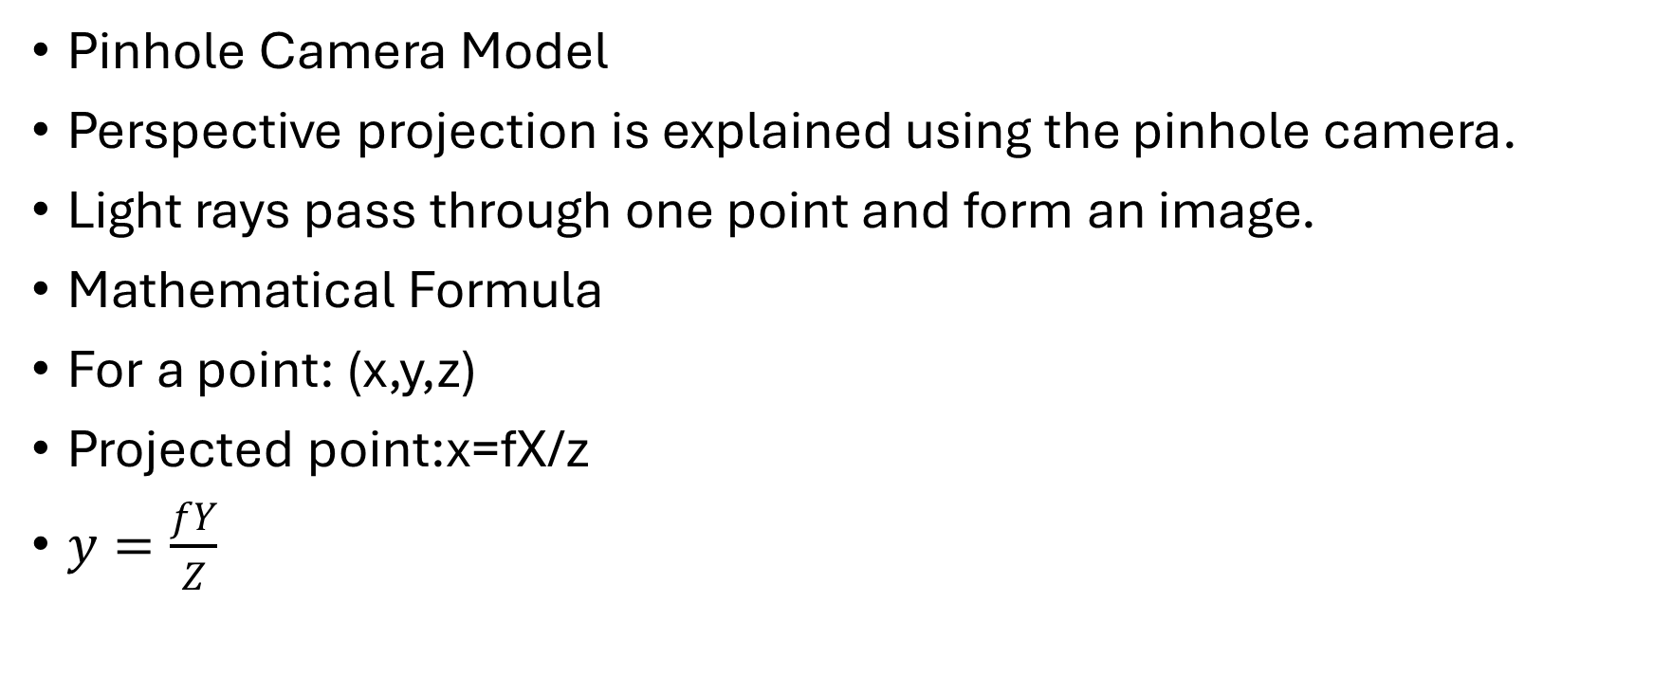
Pinhole Camera Model
Perspective projection is explained using the pinhole camera.
Light rays pass through one point and form an image.
Mathematical Formula
For a point: (x,y,z)
Projected point:x=fX/z​
$y=\frac{fY}{Z}$

Slide 166
where:
f = focal length
Z = distance from camera
Understanding the Formula
x,y∝ 1/z
If distance increases Z↑
Then x,y↓
Image size decreases.

Slide 167

Numerical Example
f=50
$$X=20$$
Object at 100 cm
$$x=\frac{50×20}{100}$$
$$x=10$$

Slide 168

Object at 200 cm
x=(50×20)/200​
$x=5$
The image becomes half as large.

Slide 169
Take a selfie.
Hold your finger near the camera.
Finger → 5 cm
Face → 50 cm
Huge Finger
Smaller Face

Slide 170
The finger appears much larger.
This is perspective projection.
Characteristics
Near Objects Look Larger
Far Objects Look Smaller
Vanishing Point (Parallel Lines Appear to meet) Railway Tracks
Depth Perception

Slide 171
Depth perception is the ability to judge:
How far an object is
How close an object is
The distance between objects
Depth perception helps us see the world in 3D instead of a flat 2D image.

Slide 172
Camera and Camera Model (Computer Vision)
1. What is a Camera?
A camera is a device that captures light from the real world and converts it into a digital image.
A camera takes a 3D scene and creates a 2D image.
Example
Suppose you take a photo of an apple.

Slide 173
Apple (3D Object)
↓
Camera
↓
Apple Image (2D)

Slide 174
The real apple has:
Height
Width
Depth
But the image contains only:
Height
Width
The depth information is mostly lost.

Slide 175
Main Parts of a Camera
Scene
↓
Lens
↓
Aperture
↓
Image Sensor
↓
Digital Image

Slide 176
1. Lens
The lens collects and focuses light.
Example
A magnifying glass works like a lens.
Light Rays
\ | /
\ | /
\|/
Lens
↓
Focused Light

Slide 177
Without a lens:
Image becomes blurry.
2. Aperture
Aperture controls how much light enters.
Think of it as the camera's pupil.
Human Eye
Bright → Small pupil
Dark → Large pupil
Camera
Bright → Small aperture
Dark → Large aperture

Slide 178
3. Image Sensor
The sensor converts light into numbers.
Example
Phone Camera Sensor
Light
↓
Sensor
↓
Pixels
↓
Image

Slide 179
Image Sensor
In very simple words:
The sensor catches light.
  Each pixel acts like a tiny bucket collecting light.
The sensor measures how much light it got.
  More light = bigger electrical signal.
  Less light = smaller electrical signal.
The sensor turns that signal into a number.
  Small signal → small number.
  Large signal → large number.
These numbers are then used to create the photo.
Light → Electrical signal → Number → Image

Slide 180
Simple analogy
Imagine you're measuring rainfall:
Bucket catches rain → like the pixel catching light.
Measure water level → like measuring the electrical charge.
Write down the amount as a number → like the ADC converting it to a digital value.
The camera repeats this process for millions of pixels, creating the digital image you see.

Slide 181
4. Pixels
A sensor contains millions of pixels.
Example: 1920 × 1080
Total pixels: 2,073,600

Slide 182
What Happens When You Take a Photo?
Step 1
Object reflects light.
Sun
↓
Apple
Step 2
Light enters camera lens.

Slide 183
Apple
↓
Lens
Step 3
Lens focuses light.
Step 4
Focused light reaches sensor.
Step 5
Sensor converts light into pixels.
Step 6
Image is stored.

Slide 184
What is a Camera Model?
A camera model is a mathematical representation of how a camera forms an image.
A camera model explains how a 3D point becomes a 2D pixel.
Why Do We Need a Camera Model?
The computer must understand:
Real World
↓
Camera
↓
Image using mathematics

Slide 185
The Most Important Camera Model
Pinhole Camera Model
This is the basic camera model used in Computer Vision.
Pinhole Camera
Imagine a box with a tiny hole.
Object
↓
Pinhole
↓
Image Plane

Slide 186
Light enters only through the hole.
How Image Formation Happens
Object
\ | /
\ | /
\ | /
\|/
Pinhole
|
|
Image Plane

Slide 187
All rays pass through one point.
This point is called camera center.
The image formed is upside down.
Real Object
↑
|
|
Image
|
|
↓
Real cameras later flip the image electronically.

Slide 188
Camera Coordinate System
Computer vision uses coordinate system
Y
↑
|
|
O------→ X
/
/
Z

Slide 189
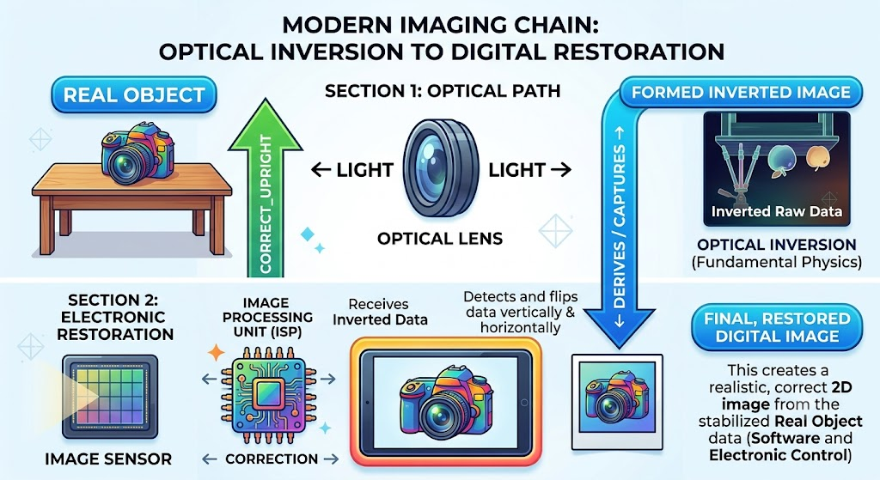

Slide 190
X-axis
Left ↔ Right
Y-axis
Up ↔ Down
Z-axis
Distance from camera
This is depth.

Slide 191

3D Point
Suppose:
$P=\left(X , Y , Z\right)$
Example:
$P=\left(10 , 5 , 100\right)$
Meaning:
10 units right
5 units up
100 units away

Slide 192

Projection
The camera converts:
$\left(X , Y , Z\right)$
into:
$\left(x , y\right)$
on the image.

Slide 193

Perspective Projection Equation
The pinhole camera uses:
$x=\frac{fX}{Z}$
$y=\frac{fY}{Z}$
where:
$f$= focal length
$Z$= depth

Slide 194

Understanding the Formula
Suppose:
$f=50$
$X=20$
$Z=100$
Then:
$x=\frac{50×20}{100}$
$x=10$

Slide 195

Now move object farther.
$Z=200$
$x=\frac{50×20}{200}$
$x=5$
The image becomes smaller.
This is why far objects look smaller.

Slide 196
Intrinsic Parameters
These describe the camera itself.
Include
Focal length
Sensor size
Principal point
Pixel size

Slide 197
Focal Length
Distance between lens and sensor.
Measured in:
mm
Effect
Small focal length:
Wide View
Large focal length:
Zoom View

Slide 198
Extrinsic Parameters
These describe the camera position.
Include
Rotation
Translation
Translation
Where the camera is located.
Example:
Camera at (0,0,0)
or
Camera at (10,5,2)

Slide 199
Rotation
Where the camera is looking.
Example:
Left
Right
Up
Down

Slide 200
Camera Calibration
Camera calibration is the process of finding the true properties of a camera.
Think of it like measuring and correcting a camera so that the computer knows exactly how the camera sees the world.
Camera calibration is used to find camera parameters such as focal length, camera center, and lens distortion.

Slide 201
Why Do We Need Calibration?
Real cameras are not perfect.
Problems:
Lens distortion
Unknown focal length
Slight manufacturing differences

Slide 202
Without calibration:
Real Object
↓
Camera
↓
Incorrect Measurements

Slide 203
With calibration:
Real Object
↓
Calibrated Camera
↓
Accurate Measurements

Slide 204
Example
Suppose you want to measure a box using a camera.
Real Box Width = 20 cm
Because of lens distortion, the image may suggest:
22 cm
Calibration helps correct this error.

Slide 205
What Does Calibration Find?
1. Focal Length (f)
Distance-related camera parameter.
Example:
f = 800 pixels
2. Principal Point
The center of the image.
Usually close to:
(cx, cy)

Slide 206
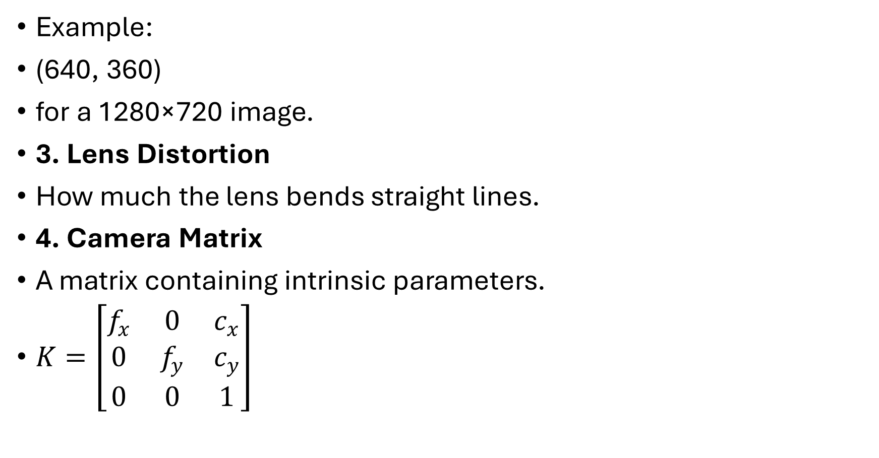
Example:
(640, 360)
for a 1280×720 image.
3. Lens Distortion
How much the lens bends straight lines.
4. Camera Matrix
A matrix containing intrinsic parameters.
$K=\left[\begin{matrix}f_{x} & 0 & c_{x} \\ 0 & f_{y} & c_{y} \\ 0 & 0 & 1\end{matrix}\right]$

Slide 207
fx
Horizontal focal length
Large fx → Zoomed image
Small fx → Wide image
fy
Vertical focal length

Slide 208
cx
Image center (x-coordinate)
Example:
Image Width = 640
cx = 320

Slide 209
cy
Image center (y-coordinate)
Example:
Image Height = 480
cy = 240

Slide 210

1
It helps matrix mathematics work correctly.
Example Camera Matrix
$K=\left[\begin{matrix}800 & 0 & 320 \\ 0 & 800 & 240 \\ 0 & 0 & 1\end{matrix}\right]$

Slide 211
Focal Length = 800 pixels
Image Center = (320,240)
What Does Camera Matrix Do?
The Camera Matrix converts camera coordinates into image pixel coordinates.
3D Camera Coordinates
↓
Camera Matrix
↓
2D Pixel Coordinates

Slide 212
Example
Imagine you buy a new ruler.
Before using it, you check whether:
Is 1 cm really 1 cm?
Is the ruler bent?
Are the markings correct?
This checking process is called calibration.
The same idea applies to cameras.

Slide 213
Camera Calibration is the process of finding the true properties of a camera so that it can measure objects accurately.
Why Do We Need Calibration?
Real cameras are not perfect.
Problems include:
Lens bends light.
Image may look curved.
Camera does not know its exact focal length.
Camera does not know the exact image center.

Slide 214
Without calibration:
Real Object
↓
Camera
↓
Wrong Measurements

Slide 215
With calibration:
Real Object
↓
Calibrated Camera
↓
Correct Measurements

Slide 216
Real-Life Example
Suppose a box is actually 20 cm wide.
Without calibration, the computer might calculate:
20 cm → 18 cm
After calibration:
20 cm → 20 cm

Slide 217
What Does Calibration Find?
1. Focal Length
How much the camera zooms.
2. Principal Point
The center of the image.
Example:
Image size:
640 × 480
Image center:
(320,240)

Slide 218
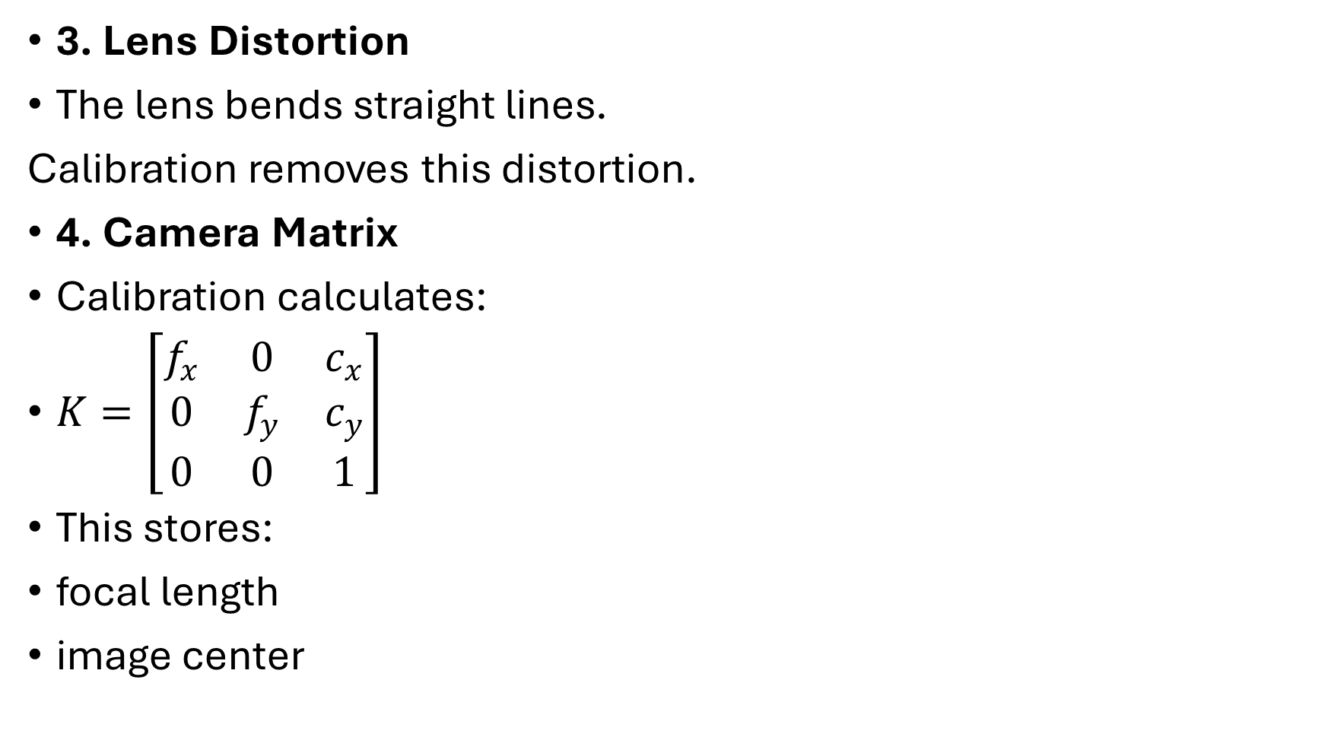
3. Lens Distortion
The lens bends straight lines.
Calibration removes this distortion.
4. Camera Matrix
Calibration calculates:
$K=\left[\begin{matrix}f_{x} & 0 & c_{x} \\ 0 & f_{y} & c_{y} \\ 0 & 0 & 1\end{matrix}\right]$
This stores:
focal length
image center

Slide 219
How is Calibration Done?
The most common method uses a chessboard pattern.
Why Chessboard?
Because the corners are easy to detect.
⬜⬛⬜⬛⬜
⬛⬜⬛⬜⬛
⬜⬛⬜⬛⬜
⬛⬜⬛⬜⬛

Slide 220
Each corner has a known position.
Calibration Steps
Step 1
Print a chessboard.
Step 2
Take many photos.
Example:

Slide 221
Front
Tilt left
Tilt right
Move up
Move down
Take 15–30 images.

Slide 222
Step 3
Detect corners.
OpenCV finds every corner automatically.
●----●----●
| | |
●----●----●
| | |
●----●----●

Slide 223
OpenCV does not magically know where the corners are. It uses image processing algorithms to detect them.
Imagine This Chessboard
Each place where 4 squares meet is a corner.
OpenCV Looks for Color Changes
OpenCV checks every pixel.
If the brightness changes suddenly in both horizontal and vertical directions, it is likely a corner.
Example: white -> black
This is an edge.

Slide 224
Now look here:
⬜⬛
⬛⬜
The color changes in both directions.
This is a corner.
Mark Possible Corners
⬜⬛⬜⬛
⬛🔴⬛🔴
⬜⬛⬜⬛
⬛🔴⬛🔴
🔴 = Possible corner detected.

Slide 225
OpenCV Knows the Chessboard Pattern
When using
cv2.findChessboardCorners()
OpenCV already knows that the board has a fixed pattern.
⬜⬜⬜⬛⬛⬛
it's just an edge.
But if the colour changes in both directions:
⬜⬛
⬛⬜
then it is probably a corner.

Slide 226
It marks all the corners 🔴
⬜⬛⬜⬛
⬛🔴⬛🔴
⬜⬛⬜⬛
⬛🔴⬛🔴
The 🔴 marks are the detected corners.
It counts the corners
Walking on a straight wall → edge
Reaching the place where two walls meet → corner
OpenCV does something similar. It looks for places where the image changes in two directions instead of just one.

Slide 227
OpenCV automatically finds corners by looking for places where the image changes sharply in both horizontal and vertical directions.
It then matches these points to the expected chessboard pattern and gives the exact corner positions.

Slide 228
Step 4
Compare
Known corner positions
with
Detected corner positions.

Slide 229
Step 5
OpenCV calculates
Camera Matrix
Distortion coefficients
Now the camera is calibrated.

Slide 230
Simple Practical Example
Suppose a chessboard square is:
2 cm × 2 cm
OpenCV already knows this.
If the image shows a different size because of the lens, OpenCV estimates the camera's properties and corrects the measurements.

Slide 231
Applications of Calibration
Measuring object sizes
Robotics
Self-driving cars
Medical imaging
Augmented Reality (AR)
3D reconstruction

Slide 232
Chessboard
↓
Take Multiple Images
↓
Detect Corners
↓
Calculate Camera Matrix
↓
Remove Distortion
↓
Accurate Camera

Slide 233
Binocular Imaging System
What Does "Binocular" Mean?
"Bi" means two.
A binocular imaging system uses two cameras.
Example:
📷 📷
Left Right

Slide 234
Human Vision
Humans have:
👁 👁
Two eyes.
Each eye sees a slightly different image.
The brain combines them.
This helps us judge:
distance
depth

Slide 235
Computer Vision
Instead of eyes:
📷 📷
Two cameras capture the same object.
Example
Suppose there is a ball.
📷 ⚽ 📷
Both cameras take a picture.
Left Camera Image
Ball at x = 120

Slide 236
Right Camera Image
Ball at x = 150
Notice the ball appears at different positions.
This difference is called disparity.
What is Disparity?
Disparity is the difference in the object's position in the left and right images.

Slide 237
Example:
Left image:
x = 120
Right image:
x = 150
Disparity:
150 − 120 = 30 pixels

Slide 238
Why is Disparity Important?
Disparity tells us how far away the object is.
Large disparity
Left = 100
Right = 180
Difference = 80

Slide 239
Large difference means:
Object is close.
Small disparity
Left = 100
Right = 105
Difference = 5

Slide 240
Small difference means:
Object is far away.
Easy Analogy
Hold one finger in front of your face.
Close your left eye.
Now close your right eye.
Your finger appears to move.
That movement is similar to disparity.
Your brain uses it to estimate distance.

Slide 241
Baseline
The distance between the two cameras is called the baseline.
Focal Length
Each camera has a focal length.
Example:
f = 800 pixels

Slide 242
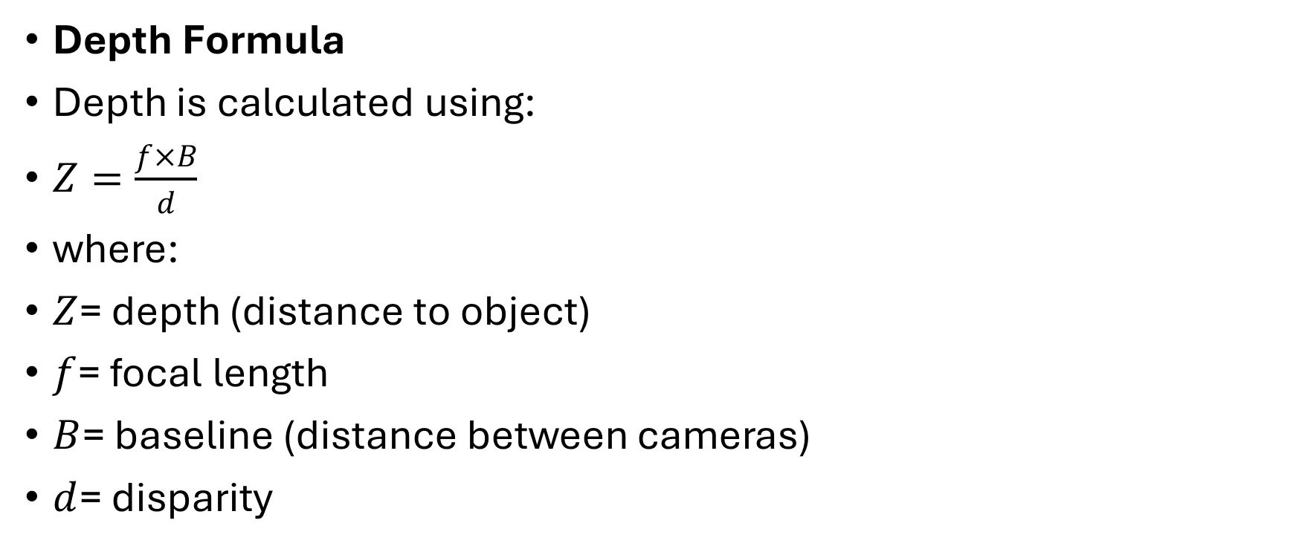
Depth Formula
Depth is calculated using:
$Z=\frac{f×B}{d}$
where:
$Z$= depth (distance to object)
$f$= focal length
$B$= baseline (distance between cameras)
$d$= disparity

Slide 243
Numerical Example
Suppose:
f = 800 pixels
B = 10 cm
d = 40 pixels

Slide 244

Then:
$Z=\frac{800×10}{40}=200\text{ cm}$
The object is 2 metres away.

Slide 245
How Binocular Imaging Works
Real Object
↓
Two Cameras Capture Images
↓
Find Same Object in Both Images
↓
Calculate Disparity
↓
Estimate Depth
↓
Create 3D Understanding

Slide 246
Practical Applications
1. Self-Driving Cars
Estimate:
distance to cars
pedestrians
traffic signs

Slide 247
2. Robots
Robots use stereo cameras to avoid obstacles.
3. Drones
Drones estimate the height of buildings and trees.

Slide 248
4. Face Unlock
Some phones use depth sensors or stereo-style systems to distinguish a real face from a flat photo.
5. 3D Mapping
Stereo cameras build 3D models of rooms, roads, and buildings.

Slide 249
Feature | Monocular | Binocular
Number of cameras | 1 | 2
Similar to | One eye | Two eyes
Depth estimation | Difficult | Easy
Cost | Lower | Higher
3D information | Limited | Better

Slide 250
One Camera
↓
Take One Picture
↓
Mostly 2D Information

Slide 251
Binocular
Two Cameras
↓
Take Two Pictures
↓
Compare Both Images
↓
Find Disparity
↓
Calculate Depth
↓
3D Information

Slide 252
Camera Calibration
Think of it as:
"Teaching the camera about itself."
Chessboard
↓
Find camera properties
↓
Correct measurements

Slide 253
Binocular Imaging
Think of it as:
"Giving the computer two eyes."
Two Cameras
↓
Two Images
↓
Disparity
↓
Depth

Slide 254
Camera Calibration
Camera calibration is the process of finding a camera's intrinsic parameters (camera matrix), extrinsic parameters (position and orientation), and lens distortion coefficients using a known reference object (such as a chessboard) so that the camera can make accurate measurements and produce undistorted images.
Binocular Imaging System
A binocular imaging system uses two cameras placed a fixed distance apart to capture the same scene from two different viewpoints. By comparing the position of objects in the two images (disparity), the system estimates the depth or distance of objects, enabling 3D perception.

Slide 255
Lens Distortion in Computer Vision (CV)
Imagine you are looking through a camera lens.
If the lens were perfect, straight lines in the real world would stay straight in the image.
But real camera lenses are not perfect. They bend light a little differently near the edges.
This makes the image look slightly warped or curved. This effect is called Lens Distortion.

Slide 256
Think of it like this
Imagine looking through a glass marble.
The center looks normal.
The edges look bent or stretched.
That's exactly what happens with some camera lenses.

Slide 257
Imagine you draw a perfect square on a paper.
In real life, it looks like this:
The lines are straight.
Now take a photo with a camera
Sometimes the camera lens bends the image.
Instead of seeing straight lines, the image becomes curved.

Slide 258
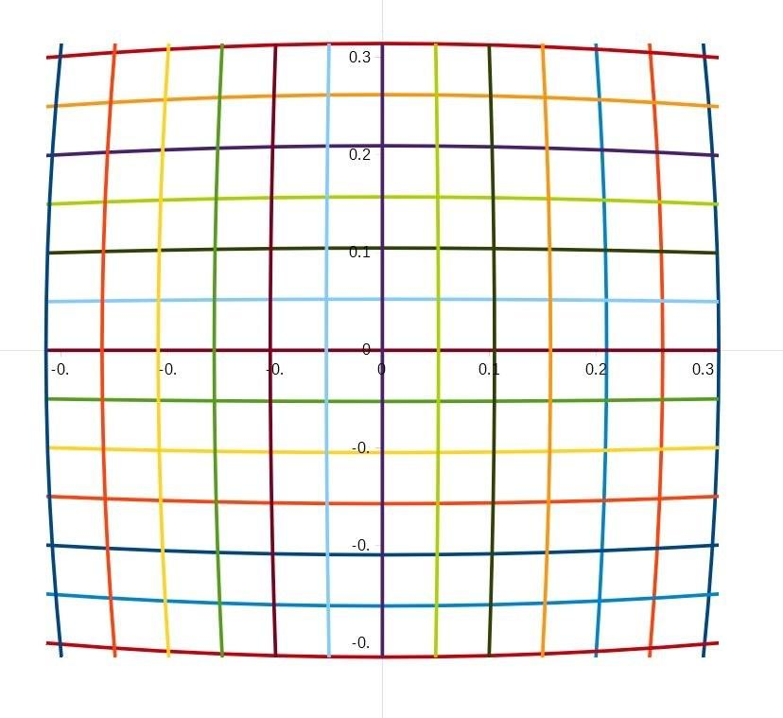
1. Barrel Distortion

Slide 259
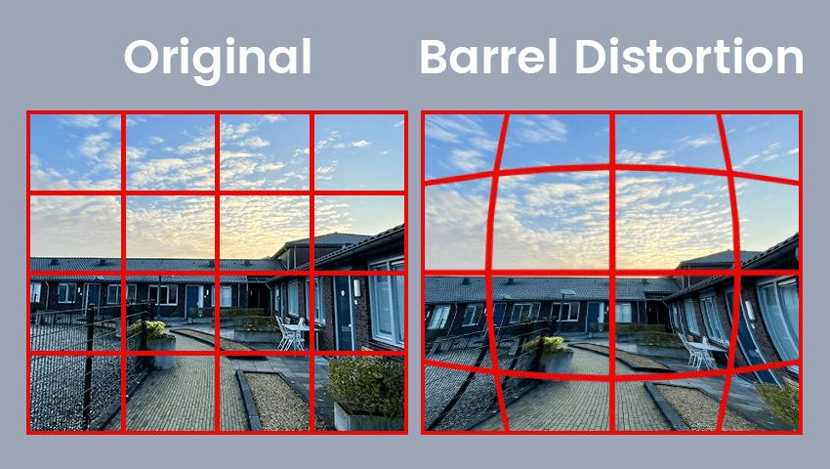

Slide 260
Imagine the picture is wrapped around a balloon.
The edges bulge outward.
What happens?
Centre looks normal.
Edges bend outward.
Straight lines become curved

Slide 261
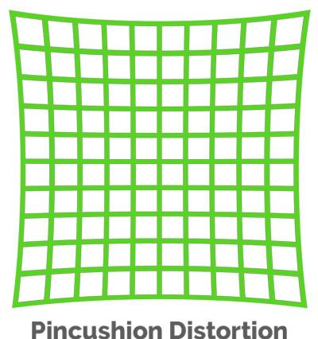
2. Pincushion Distortion

Slide 262
Pincushion distortion happens when the edges of an image bend inward toward the centre.
Imagine pulling the four corners of a photo toward the middle.

Slide 263
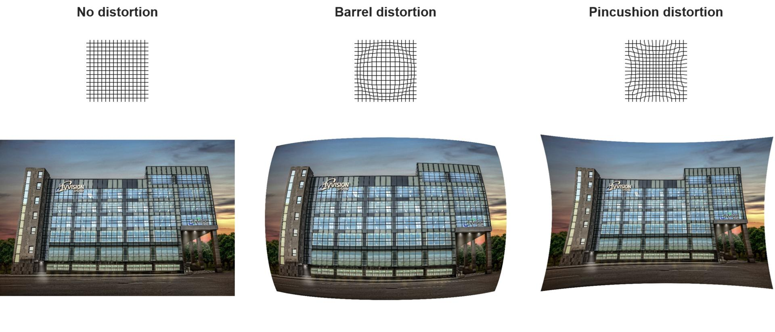

Slide 264
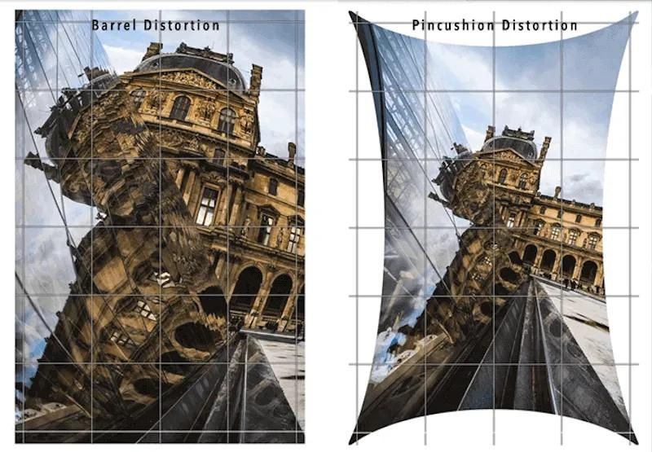

Slide 265
What happens?
Centre looks almost normal.
Edges bend inward.
Pin = Pulls In

Slide 266
How does OpenCV fix it?
Distorted Image
↓
Camera Calibration
↓
OpenCV learns the distortion
↓
Corrected Image
OpenCV measures how much the lens bends the image and then straightens the curved lines.

Slide 267
Type | What happens? | Easy Memory
Barrel Distortion | Edges curve outward | Balloon expands
Pincushion Distortion | Edges curve inward | Pin pulls inward

Slide 268
Lens Distortion
Real lenses are imperfect.
Straight lines may appear curved.
Barrel Distortion
  Image bulges outward.
Pincushion Distortion
  Image bends inward.

Slide 269
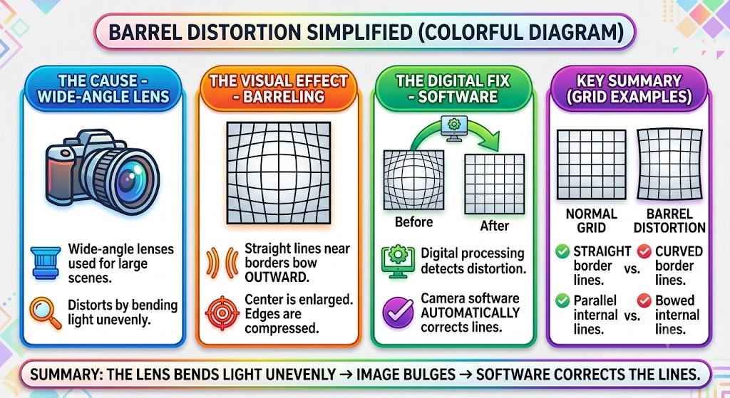

Slide 270
Types of Camera Models
1. Pinhole Camera Model
Most common.
2. Perspective Camera Model
Uses perspective projection.
3. Orthographic Camera Model
No depth effect.
Used in engineering.

Slide 271
Multiple View Geometry
magine you have a toy car.
You take one photo from the front and another photo from the side.
From just one picture, you cannot know the car's real depth.
But with multiple pictures, your brain can understand its 3D shape.
This is exactly what Multiple View Geometry does.

Slide 272
What is Multiple View Geometry?
Multiple View Geometry is the process of using two or more images of the same object taken from different positions to understand its 3D shape and location.
Think about your own eyes.
👁 Left Eye
👁 Right Eye
Both see the same object from slightly different positions.

Slide 273
Your brain combines both images and understands
Distance
Depth
Shape
Computer Vision does the same thing with cameras.

Slide 274
Example 1 – Looking at a Ball
Suppose a football is on the ground.
Camera A
C
\
\
B

Slide 275
Camera B
C
/
/
B

Slide 276
Each camera sees the ball from a different angle.
Neither camera alone knows exactly where the ball is.
When both images are combined,
Computer Vision finds the exact 3D position.

Slide 277
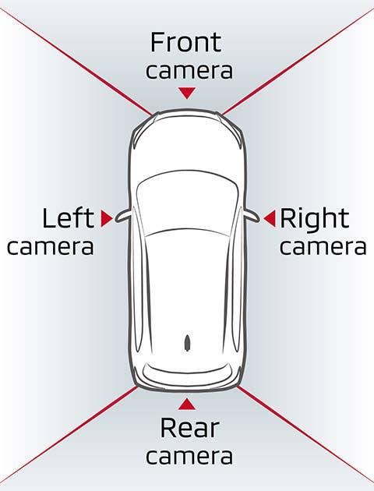
Real-Life Example
Self-driving cars use
Front camera
Left camera
Right camera

Slide 278
ch camera captures a different view.
The computer combines all the images.
Now it knows
Where the pedestrian is
How far the car is
Road shape

Slide 279
Why is One Camera Not Enough?
Imagine this picture.
Camera
Car
The car looks close.
But maybe
Camera
Car

Slide 280
The car is actually far away.
From one image,
the computer cannot measure depth accurately.

Slide 281
Using Two Cameras
Camera A ----------- Car ----------- Camera B
Now both cameras see the car.
Because they see it from different positions,
Computer Vision calculates
Distance
Height
Width
Position

Slide 282
Human Eyes Example
Your eyes are about 6–7 cm apart.
Left Eye
👁
\
🍎
Right Eye
👁
/
🍎

Slide 283
Your brain compares both images.
That's why you know
Apple is near
Apple is round
Apple is floating or resting
This is called stereo vision.
Computer Vision copies this idea.

Slide 284
What is Structure Determination?
Now suppose the computer has
10 photos of a building.
The computer asks
"Can I build the entire building in 3D?"
The answer is
Yes!
This process is called
Structure Determination

Slide 285
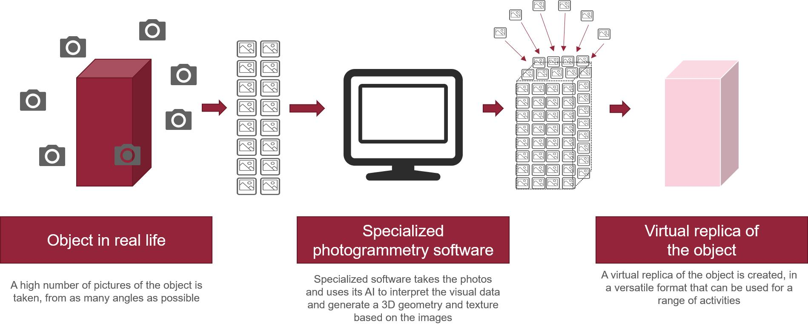

Slide 286
Structure Determination is the process of finding the 3D shape of an object using multiple images.
Instead of just seeing the object,
the computer actually reconstructs its shape.
Example
Imagine a cube.
  From the front
    Looks like a square.
  From the side
    Still looks like a square.
    From the top
      Again looks like a square.

Slide 287
One picture cannot tell whether it is
a square
a box
or a cube.
But combining all views,
Computer Vision understands
It is a cube!
This is Structure Determination.

Slide 288
Another Example – Mobile Face Unlock
When setting up Face ID,
the phone asks you to move your head.
Why?
Because
one photo is not enough.
It needs
Front
Left
Right

Slide 289
Slightly Up
Slightly Down
All these views help create a 3D model of your face.
That is another example of Structure Determination.

Slide 290
Multiple View Geometry | Structure Determination
Uses many images | Uses those images to build a 3D model
Finds depth and camera positions | Finds the object's actual 3D shape
Compares different views | Reconstructs the object
Input stage | Output stage

Slide 291
Multiple View Geometry
Many Photos ➜ Understand Depth
Where is the object?
Structure Determination
Many Photos ➜ Build the Object
(3D Model)

Slide 292
Multiple View Geometry
Multiple View Geometry is a computer vision technique that uses two or more images of the same object taken from different viewpoints to estimate its depth, position, and spatial relationships.
Structure Determination
Structure Determination is the process of reconstructing the 3D shape or structure of an object or scene from multiple images taken from different viewpoints.

Slide 293
Multiple View Geometry = "Many cameras understand where things are."
Structure Determination = "Many camera images build a 3D object."

Slide 294
Take Multiple Photos
│
▼
Find Same Points
│
▼
Compare All Views
│
▼
Calculate Depth
│
▼
Build 3D Shape

Slide 295
1. Take Multiple Photos
Take photos of the same object from different angles.
Example: Take front, left, and right photos of a car.
2. Find Same Points
Find the same corners or features in every photo.
Example: The computer finds the same headlight, same wheel, and same door handle in all the car photos.

Slide 296
3. Compare All Views
Compare where the same points appear in each photo.
Example: The headlight is on the left in one photo but more towards the centre in another photo.
4. Calculate Depth
Use these differences to find how far each point is from the camera.
Example: The computer calculates that the car is 5 metres away.

Slide 297
5. Build 3D Shape
Combine all the depth information to create a 3D model of the object.
Example: The computer builds a complete 3D model of the car.

Slide 298
Shape from Shading (SFS)
These are two important techniques in Computer Vision used to find the 3D shape of an object.
The difference is:
Shape from Shading (SFS) → Uses one image.
Photometric Stereo → Uses many images with different lighting.

Slide 299
1. Shape from Shading (SFS)
Shape from Shading is a technique that estimates the 3D shape of an object by looking at the light and dark areas in a single image.
It means that the computer tries to understand the real shape of an object, not just its flat picture.
Simple Idea
Imagine a ball.
Even though the picture is flat (2D), you can tell it is round because of the shading.

Slide 300


Slide 301
Why?
Suppose light comes from the left.
The left side becomes bright.
The right side becomes dark.
Your brain immediately thinks,
"This must be a round ball."
Computer Vision learns the same thing.

Slide 302
Everyday Example
Suppose someone shows you the picture of orange.
It looks flat.
Now look at this.
It looks like an orange.
Why?
Because the light and shadow tell your brain about the shape.

Slide 303
How Shape from Shading Works
Step 1
Take one image.
Step 2
Find bright and dark regions.
Step 3
Estimate the surface slope.

Slide 304
Bright
↓
Surface facing light
Dark
↓
Surface facing away

Slide 305
Step 4
Create a 3D shape.
Example
Imagine a mountain.
Without shading
With shading
Now it looks like a real mountain.
The computer estimates the mountain's shape from the shading.

Slide 306
Uses only one image.
If lighting is incorrect,
the estimated shape may also be incorrect.
One Image + Light & Shadow = Shape

Slide 307
Photometric Stereo
Now imagine something different.
Instead of changing the camera,
you keep the camera fixed.
Only the light direction changes.
Photometric Stereo estimates the 3D shape of an object by using multiple images taken from the same camera position but with different lighting directions.

Slide 308
Imagine This
Camera never moves.
Only the light moves.
Image 1
Light from Left
Ball becomes bright on the left.

Slide 309
Image 2
Light from Right
Now the right side becomes bright.
Image 3
Light from Top
Now the top becomes bright.

Slide 310


Slide 311
What does the computer do?
It compares all the images.
For every pixel,
it asks
"Why is this point bright here but dark there?"
From this,
it calculates
Surface direction
Surface angle
3D shape

Slide 312
Step-by-Step Process
Step 1
Keep camera fixed.
Step 2
Take many images.

Slide 313
Step 3
Measure brightness.
Image 1
Bright
Image 2
Dark
Image 3
Medium

Slide 314
Step 4
Estimate surface direction.
The computer figures out which way each part of the object's surface is facing.
Step 5
Build 3D object.

Slide 315
Real-Life Example
Imagine your face.
Light from left
Light from right
Light from Top
Every picture looks slightly different.
Using all of them,
Computer Vision builds a detailed 3D face.

Slide 316
Difference Between Shape from Shading and Photometric Stereo
Shape from Shading | Photometric Stereo
Uses 1 image | Uses many images
Light is fixed | Camera is fixed, light changes
Less accurate | More accurate
Estimates shape from shadows | Estimates shape by comparing different lighting
Faster | More detailed

Slide 317
Easy Comparison
Shape from Shading
Computer says:
"I'll guess the shape using the shadows."
Photometric Stereo
Computer says:
"I have many lighting conditions, so I can calculate the shape more accurately."

Slide 318
Easy Way to Remember
Shape from Shading
One photo
➜ Look at light and shadow
➜ Estimate shape

Slide 319
Photometric Stereo
Many photos
Different light directions
➜ Compare brightness
➜ Build accurate 3D shape

Slide 320
Shape from Shading
Shape from Shading is a computer vision technique that estimates the 3D shape of an object from a single image by analysing its shading (light and dark regions).
Photometric Stereo
Photometric Stereo is a computer vision technique that estimates the 3D shape of an object using multiple images taken from the same camera position under different lighting directions.

Slide 321
Shape from Shading = One Photo + Shadows = Estimate Shape
Photometric Stereo = Many Photos + Different Lights = Accurate 3D Shape

Slide 322
Depth from Defocus (DFD)
Depth from Defocus (DFD) is a technique in Computer Vision used to estimate how far an object is from the camera by analysing how blurred (out of focus) it appears in an image.
Simply put:
Near or far objects become blurry when they are not in focus. By measuring the amount of blur, a computer can estimate the object's distance (depth).

Slide 323
Real-life Example
Imagine you are taking a photo of a flower.
You focus your camera on the flower.
The flower looks sharp.
The trees behind it look blurred.

Slide 324
Or,
You focus on the trees.
Now the trees become sharp.
The flower becomes blurred.
The amount of blur tells us which object is closer or farther.

Slide 325
Example
Camera
|
|
Flower Tree
Focus on Flower
Flower = Sharp
Tree = Blurry

Slide 326
The camera changes its lens to focus on one distance at a time.
What is Depth?
Depth means
Distance between the camera and the object.
Camera ------------ Apple
Distance = 50 cm
Camera ---------------------- Chair
Distance = 200 cm

Slide 327
The apple has less depth (closer).
The chair has more depth (farther).
What is Defocus?
Defocus means
The image becomes blurry because the object is not at the camera's focus distance.
Example
Suppose your eyes focus on a book.
Book ---- Wall
Book = Clear
Wall = Blur

Slide 328
Now focus on the wall.
Book = Blur
Wall = Clear
This blur is called defocus blur.

Slide 329
Why does Blur Occur?
A camera lens can focus only one distance perfectly at a time.
Objects
nearer than the focus distance
farther than the focus distance
become blurred.

Slide 330
Example
Focus distance = 2 metres
1 metre object → Blur
2 metre object → Sharp
4 metre object → Blur

Slide 331
Main Idea of Depth from Defocus
Instead of measuring distance directly,
the computer measures
How much blur is present.
More blur
↓
More difference from the focus plane
↓
Estimate depth.

Slide 332
Everyday Example
Imagine writing with a pencil.
Hold the pencil very close to your eyes.
Move it a little away.
Move it a too far.
Your eyes automatically focus.
The same happens in cameras.

Slide 333
How Does the Computer Do It?
Step 1
Capture an image.
Step 2
Find sharp regions.
Step 3
Find blurred regions.
Step 4
Estimate blur amount.

Slide 334
Object | Blur
Book | 2
Cup | 5
Tree | 10

Slide 335
Step 5
Convert blur into depth.
Small Blur
↓
Near Focus
Large Blur
↓
Far from Focus

Slide 336
Simple Example
Suppose we have
Camera
Person
Ball
Mountain
Camera focuses on the person.
Result

Slide 337
Person → Sharp
Ball → Slight blur
Mountain → Heavy blur

Slide 338
Computer estimates:
Object | Blur | Estimated Distance
Person | 0 | 2 m
Ball | 4 | 5 m
Mountain | 10 | 500 m

Slide 339
Mathematical Idea (Very Simple)
Blur size is often represented by the Circle of Confusion (CoC).
Small blur circle → Image is almost in focus.
Large blur circle → Image is far from the focus plane.

Slide 340
Applications
Mobile Phone Portrait Mode
Phones estimate depth and blur the background to create a portrait effect.
Depth from Defocus | Stereo Vision
Uses one camera | Uses two cameras
Measures blur | Measures differences between two images (disparity)
Simple hardware | Requires camera calibration and matching
Good for close objects | Good for a wide range of distances

Slide 341
Depth from Defocus (DFD) is a computer vision technique that estimates the distance (depth) of an object by analysing the amount of defocus blur in one or more images.
Objects that are out of the camera's focus appear blurrier, and the amount of blur is used to infer how far they are from the camera.

Slide 342
OpenCV Function | Full Form | Simple Explanation
cv2.THRESH_BINARY | Binary Threshold | If the pixel value is greater than the threshold, it becomes white (255). Otherwise, it becomes black (0).
cv2.THRESH_BINARY_INV | Binary Threshold Inverse | Opposite of Binary. If the pixel value is greater than the threshold, it becomes black (0). Otherwise, it becomes white (255).
cv2.THRESH_TRUNC | Truncate Threshold | If the pixel value is greater than the threshold, it is replaced with the threshold value. Smaller values stay the same.
cv2.THRESH_TOZERO | Threshold to Zero | If the pixel value is less than or equal to the threshold, it becomes 0 (black). Higher values remain unchanged.
cv2.THRESH_TOZERO_INV | Threshold to Zero Inverse | Opposite of TOZERO. If the pixel value is greater than the threshold, it becomes 0 (black). Lower values remain unchanged.

Slide 343
OpenCV Function | Purpose | Simple Explanation
cv2.imread() | Read Image | Loads an image from a file.
cv2.imshow() | Show Image | Displays an image in a window.
cv2.imwrite() | Write Image | Saves an image to a file.
cv2.waitKey() | Wait for Key | Waits until a key is pressed.
cv2.destroyAllWindows() | Close Windows | Closes all OpenCV windows.
cv2.resize() | Resize Image | Changes the width and height of an image

Slide 344
OpenCV Function | Purpose | Simple Explanation
cv2.imread() | Read Image | Loads an image from a file.
cv2.imshow() | Show Image | Displays an image in a window.
cv2.imwrite() | Write Image | Saves an image to a file.
cv2.waitKey() | Wait for Key | Waits until a key is pressed.
cv2.destroyAllWindows() | Close Windows | Closes all OpenCV windows.
cv2.resize() | Resize Image | Changes the width and height of an image.
cv2.cvtColor() | Convert Color | Changes the image colour format (e.g., colour to grayscale).
cv2.GaussianBlur() | Gaussian Blur | Smooths the image and reduces noise.
cv2.blur() | Average Blur | Blurs the image using the average of nearby pixels.
cv2.medianBlur() | Median Blur | Removes salt-and-pepper noise while preserving edges.
cv2.Canny() | Canny Edge Detection | Detects the edges of objects in an image.
cv2.threshold() | Thresholding | Converts a grayscale image into a black-and-white image.
cv2.flip() | Flip Image | Flips the image horizontally, vertically, or both.
cv2.rotate() | Rotate Image | Rotates the image by 90°, 180°, or 270°.
cv2.rectangle() | Draw Rectangle | Draws a rectangle on an image.
cv2.circle() | Draw Circle | Draws a circle on an image.
cv2.line() | Draw Line | Draws a straight line on an image.
cv2.putText() | Put Text | Writes text on an image.
cv2.findContours() | Find Contours | Detects the outlines (boundaries) of objects.
cv2.drawContours() | Draw Contours | Draws the detected contours on an image.
cv2.equalizeHist() | Histogram Equalization | Improves image contrast.
cv2.dilate() | Dilation | Makes white objects appear thicker.
cv2.erode() | Erosion | Makes white objects appear thinner.
cv2.bitwise_and() | Bitwise AND | Keeps only the common parts of two images or masks.
cv2.bitwise_or() | Bitwise OR | Combines the white regions from two images or masks.
cv2.bitwise_not() | Bitwise NOT | Inverts the image colours (black ↔ white).
cv2.add() | Add Images | Adds two images together.
cv2.addWeighted() | Blend Images | Mixes two images using specified weights.
cv2.split() | Split Channels | Separates an image into Blue, Green, and Red channels.
cv2.merge() | Merge Channels | Combines separate colour channels into one image.

Slide 345
OpenCV Function | Full Form / Meaning | Purpose | Simple Explanation
cv2.imread() | Image Read | Read an image | Loads an image from a file into the program.
cv2.imshow() | Image Show | Display an image | Opens a window and displays the image.
cv2.imwrite() | Image Write | Save an image | Saves the processed image to a file.
cv2.waitKey() | Wait for Key | Pause execution | Waits until a key is pressed before continuing.
cv2.destroyAllWindows() | Destroy All Windows | Close windows | Closes all OpenCV image windows.
cv2.resize() | Resize Image | Change image size | Increases or decreases the width and height of an image.
cv2.cvtColor() | Convert Colour | Change colour space | Converts an image from one colour format to another (e.g., BGR to Grayscale).
cv2.GaussianBlur() | Gaussian Blur | Reduce noise | Smooths the image and removes small details or

